Slide 1
VIA University College
Come to Denmark – to study, to work and to live

Slide 2
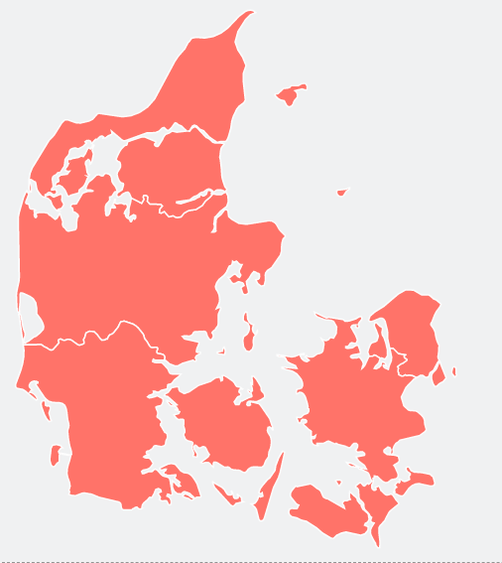

Slide 3
Why Denmark?

Slide 4
Life in Denmark
One of the world’s safest and least corrupt countries scoring high in happiness
Known for quality education and a modern education system that fosters innovative thinking
Upon graduation, Denmark can offer unique career opportunities and a good work-life balance

Slide 5
Life in Denmark
Expect living costs in total around 700-800 EUR pr. month
Student jobs available for English speakers
Danish language lessons are available for free
Housing is not an issue outside Copenhagen and Aarhus

Slide 6
Housing
Students must make their own housing arrangements in Denmark
Options include dorms, shared housing or private accommodation and prices range from 400-700 EUR
Expect costs for deposit (2-3 months rent) when signing the lease
Get more info on housing here
Notes:
Link is for VIA’s housing site that includes a video on housing

Slide 7
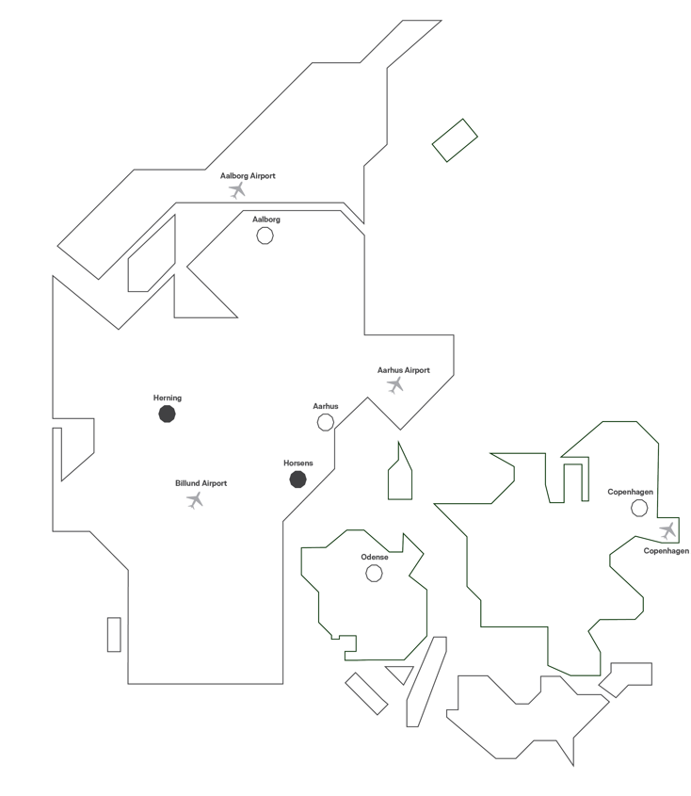
What is this VIA University College?
Denmark’s largest university of applied sciences with 8 campuses in the Aarhus area
Public institution
19,000 students of which 2,300 are internationals
42 degree programmes, 9 available in English

Slide 8
Student life at VIA

Slide 9
A different way of teaching
Problem-based learning, company visits and mandatory internships
Small-sized classes to promote active participation
Lecturers will not give you all the answers and your relationship with them will be informal
“Work-life balance” also as a student

Slide 10
Unique student facilities
Access to campus, labs and workshops 24/7
Group rooms on campus, Maker Space and Student Incubator
Student organisations, café and clubs
Career Service Center offering career events and counselling

Slide 11
Discover the degree programmes

Slide 12
Campus Herning

Slide 13
Design and Business
AP Degree in Design, Technology and Business
BA top-up in Design and Business
Specialise in Fashion Design or Branding and Marketing Management as well as Entrepreneurship (only top-up)
Notes:
During the first semester, all AP undergraduates follow the same common core programme centred on design, business and knowledge of materials. Students will develop a deeper understanding of all aspects of the design and business branch. After the first semester, students will focus on their chosen speciality. They will also get the opportunity to improve their skills through elective subjects of their own interest.
After completing the AP, students need to apply again for the top-up.

Slide 14
Design and Business
Fashion Design: Get insight into the full design process, from sketch to finished presentation. Learn about target groups, trends and tendencies. Focus is on commercial design and basic skills.
Branding and Marketing Management: Develop brands and concepts using visual and strategic skills. Conduct trend and market analyses and focus on platforms, especially SoMe.
Notes:
Links are for student video cases
Fashion Design: Students will learn to take a position on existing brands, and to create a flow in their collection that matches the identity of a brand.
All sketches are done by hand, but they are also taught Adobe’s Graphic Design tools so that they can work out a presentation of their collection.
With an AP degree in Fashion Design, they will get to work in teams with other designers as well as pattern designers, marketing professionals and web managers from the lifestyle and fashion sectors. The course will introduce students to the many different professions they will encounter once they finish your education. Expect to collaborate with the other international programmes at Design, Technology and Business.
Branding and Marketing Management: Students will analyse a brand’s values as well as trends and tendencies in the global consumer market. They learn how to use various marketing channels, e.g. digital, and print media, and they will gain insights as to choosing the right channels for their concept.
Entrepreneurship (only available for BA top-up): The speciality qualifies students to work professionally with generating business ideas, projects, and concepts whether they want to establish their own company or work with development in an existing company. Focus will be on the creative sector, particularly the fashion and lifestyle industry. Through independent thinking and skilled action, students will learn to identify and apply new ideas for products and services. They will get familiar with project management and entrepreneurship.

Slide 15
Campus Horsens

Slide 16
Engineering and Construction
BA in Architechtural Technology and Construction Management:
Learn to design, plan, execute and manage construction projects e.g. single-family homes
Building construction, management and administration is in focus as well as construction law and regulations
REVIT is used for sketching and visualizing projects
Notes:
Graduates find employment as e.g. project managers, construction designer or constructing architects within consulting, architectural- or contracting companies, which is not the same as being an architect. At ATCM, building construction, management and administration is in focus, whereas architects work with the aesthetic quality and design of buildings. Choose the ATCM programme if you want to combine your creative side with technical knowledge and management skills.

Slide 17
Engineering and Construction
BA in Software Technology Engineering
Work with programming and system development
Specialisations: Data engineering, interactive media and Internet-of-Things
Facilities include IoT lab as well as an XR lab, making it possible to test multiple theories in practice

Slide 18
Engineering and Construction
BA in Climate and Supply Engineering
Focus on ensuring a supply of clean drinking water, protecting ground water sources, and developing the sustainable energy supply of the future
Work on real-life challenges, e.g. a supply company experiencing challenges with rainwater in a new development
Have days in lab to e.g. analyse drinking water samples and measure turnover of wastewater to track the biological process of the decomposition
Notes:
Rather than studying climate change itself, you will be learning how we can adapt urban development and supply infrastructure to the consequences of climate change.
Climate and supply engineers are in high demand in Denmark and the rest of the world. Graduates typically find jobs in supply companies, consulting engineering companies, in the public sector or with environmental organisations/NGOs.

Slide 19
Admission requirements

Slide 20
Enrolment
Levels in Math, Physics, Chemistry and English available on programmes pages
Admission assignment and/or criteria due to limited seats such as motivational letter or video
Application is between 1 Feb and 15 March and deadline for payment of tuition fee (only non-EU) is 15 May
Final acceptance is 28 July
Notes:
English skills:
Danish B-level in English, min. of 210 study hours of 60 minutes each during the final three years in Upper Secondary School
IELTS (Academic) with a minimum average score of 6.5
IELTS (Academic) online test with a minimum average score of 6.5
TOEFL (iBT), Internet-based with a score of at least 83
TOEFL, Home edition with a score of at least 83
TOEFL, paper-based with the following scores: Reading - 19-23, Listening - 20-23, Writing - 24-26, Speaking - 20-22
One of the following Cambridge English tests with an average score of at least 180 (C1-level): C1 Advanced (former Cambridge English: Advanced (CAE)) C2 Proficiency (former Cambridge English: Proficiency (CPE))
VIA specific admission requirements are:
ATCM: Mat C, English C
CLIMATE: Mat A, Physics B, Chemistry C, English B
DESIGN: Mat C, English B or C (+test)
SOFTWARE: Mat A, Physics B, English B

Slide 21
Who choose to study at VIA?
VIA is Denmark’s largest university of applied sciences
VIA’s programmes offer mandatory internship periods
VIA has as international student environment with 2,300 internationals
VIA has a different way of teaching and offers small-sized classes
VIA has a Career Service Centre that helps students find internships and jobs in Denmark after graduation
VIA has been named Denmark’s leading entrepreneurial institution and works strategically with innovation activities and sustainability

