Slide 1
Managing Arrears Collection
Executive Program in Tax and Digital Transformation | 22 March 2022

Slide 2
Purpose of Lecture
Identify the critical decision points in arrears management
Discuss how data and IT systems can support the arrears management function

Slide 3
What is the goal of effective arrears management?
Minimize the financial impact of arrears
Minimize uncollectable debts, lost interests on late payments (NPV), and costs of collection
Minimize the total amount of arrears (year-on-year)
Minimize the time to bring taxpayers into compliance
Reduce the amount of uncollectable debt
Reduce the costs of collection
Reduce the time it takes to collect debts
Satisfy other goals
Minimize the number of taxpayers that experience arrears
Reduce losses due inflicted by criminals and deter future criminal acts
Respect taxpayer rights
Issues for Discussion
Which is the more important goal to your organization?
If a significant amount in fines is collected, is that a good thing?
Should fines be included in the results metrics?

Slide 4
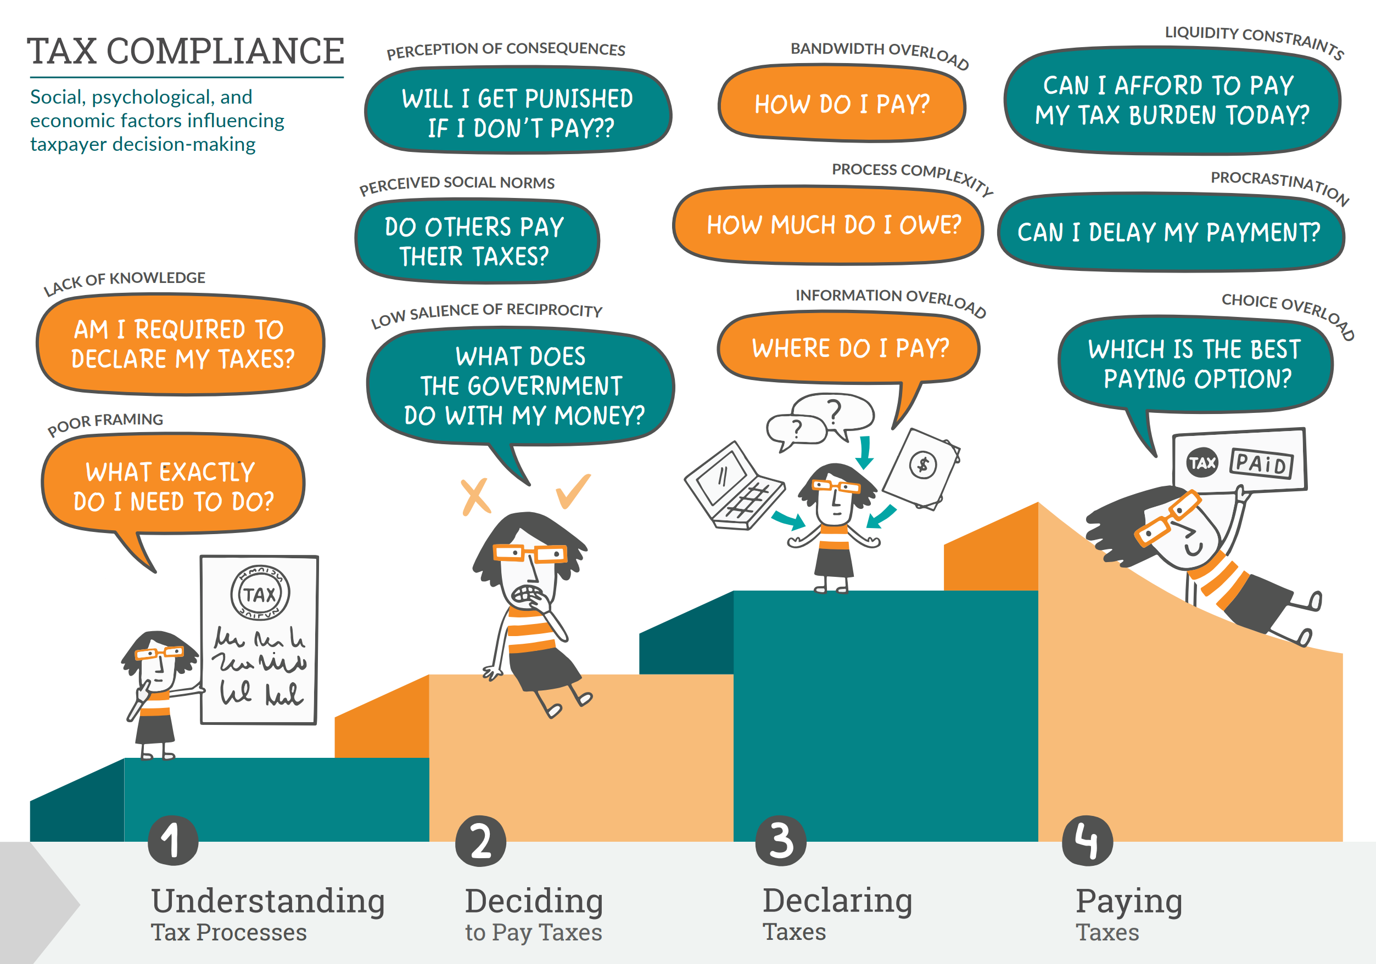
STRATEGY | Social, psychological & economic factors matter
Issues for Discussion
Which behavioral factors are more likely to contribute to arrears?
Which factors are actionable, i.e., can the tax administration do something about?
World Bank, 2021

Slide 5
STRATEGY | Approach throughout the payment process
Due Date
Due Date +12 months
Early Service
Risk Management | Communications
Late Compliance
Communications | Payment |Settlement
Very Late Enforcement
Enforcement | Collection | Investigation
Identify taxpayers at risk of arrears
Enforcement
Encourage taxpayers to pay
Triage
Write-off
Contact taxpayers directly
Increase withholding taxes
Agree on an installment plan
Make it easy to pay

Slide 6
EARLY | Tax arrears can be predicted with some accuracy
Corporate Tax Arrears Prediction
Accuracy | Data | Independent Variables | Dependent Variables | Method | Obs. | Paper
95.3% | Estonia (2011-2018) | 12 monthly amounts of tax arrears without aggregation and with aggregation of amounts in earlier months into period means, and counts of events and statistical measures | Tax arrears next month > EUR100 | Hybrid based on the random forest method | 2,978,408 | Siimon and Lukason (2021)
90.6% | China (2015–2016) | 17 balance sheet and income statement items, amount of tax arrears, industry, region, taxpayer status, type of registration and accounting system | Tax arrears next year (three classes: tax arrears above or below 5000 RMB, or no tax arrears) | Ensemble model (KNN, MLP and four tree-based models) | 120,000 | Su et al. (2018)
73.8% | Finland (2012–2014) | Financial ratios, bankruptcy risk and payment default risk in industry | Tax arrears next year (binary) | Linear discriminant analysis (LR) | 768 | Höglund (2017)
73.2% | Finland (2012–2014) | Financial ratios, bankruptcy risk and payment default risk in industry | Tax arrears same year (binary), tax arrears next year (binary) | Logit, LR and 11 machine learning methods | 768 | Abedin et al. (2020)
72.4% | Portugal (2007–2009) | Financial ratios, Taxation Effective Rate | Tax arrears next year (binary) | Discriminant analysis and logit | 600 | Batista et al. (2012)
61.6% | Finland (2004) | Financial ratios | Tax arrears in employer contribution taxes next year (binary) | Logit | 328 | Marghescu et al. (2010)
Estonia
95.3% accuracy in predicting arrear next month.
False positives (19.8%/24.8%) and false negatives (2.6%).
Companies with two or more arrears in the past 12 months had a 47.2% likelihood of an arrear the following month.
The Model
Uses monthly data to predict tax arrears in the following month among 49,156 SMEs (VAT liable with a minimum of EUR 16,000 turnover).
Avoids lag inherent in prediction of arrears on an annual basis– around three quarters of European bankrupt firms witness financial problems portrayed through financial ratios only very shortly before bankruptcy.
Avoids using financial statement information, often not available for firms in financial distress – Höglund left 63% of the companies with tax arrears out from the model because financial reports were unavailable.
Reduces the high share of firms (92%) that did not have tax arrears, focusing only on those that had two arrears among any of the 12 proceeding months because zero-valued data is difficult task for machine learning models.
Insights from the literature: Tax arrears tend to persist. Ensemble models combining several methods often provide better results. Machine learning methods have higher accuracy in bankruptcy prediction than traditional statistical methods.
Siimon and Lukason, 2021

Slide 7
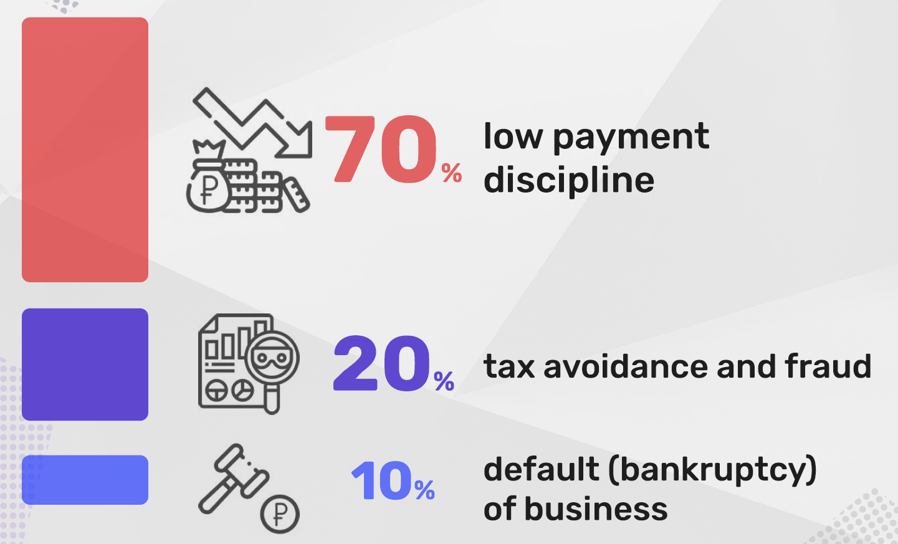
EARLY | Assess Willingness and Ability to Pay
Issues for Discussion
What do you think are the percentages in your country?
Would you consider adding other segments to the breakdown beyond the three listed here?
How would you design your IT system to capture this information?
Source: Vadim Soldatenkov, Federal Tax Service of Russia, 2022

Slide 8
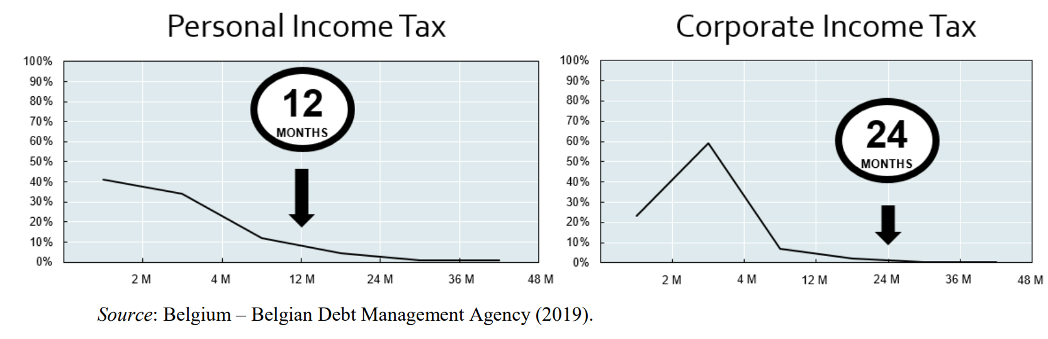
EARLY | Rate of debt recovery declines over time
Source: OECD, 2019

Slide 9
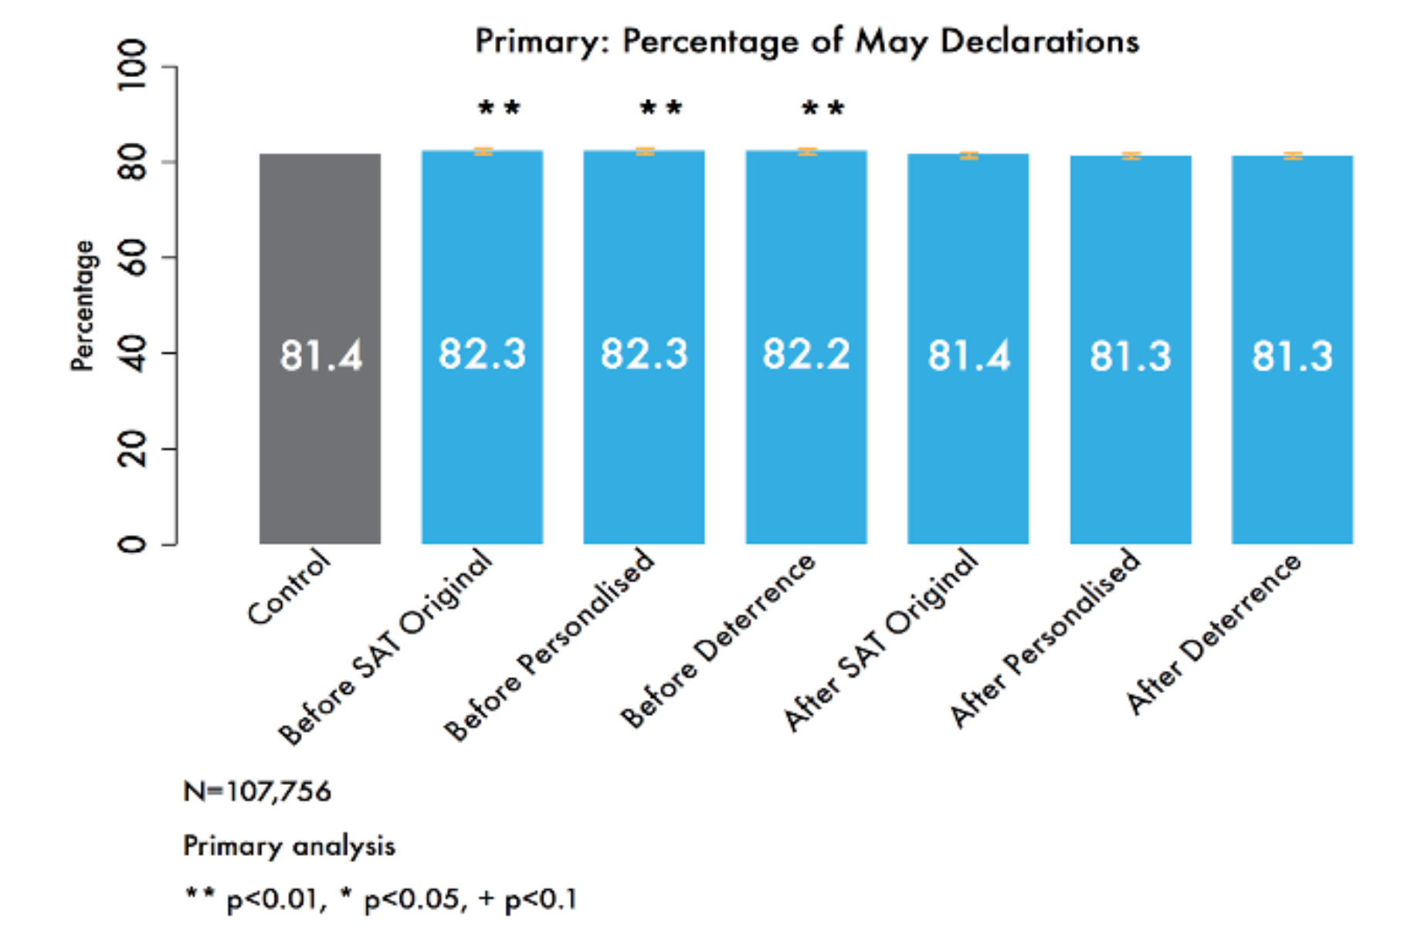
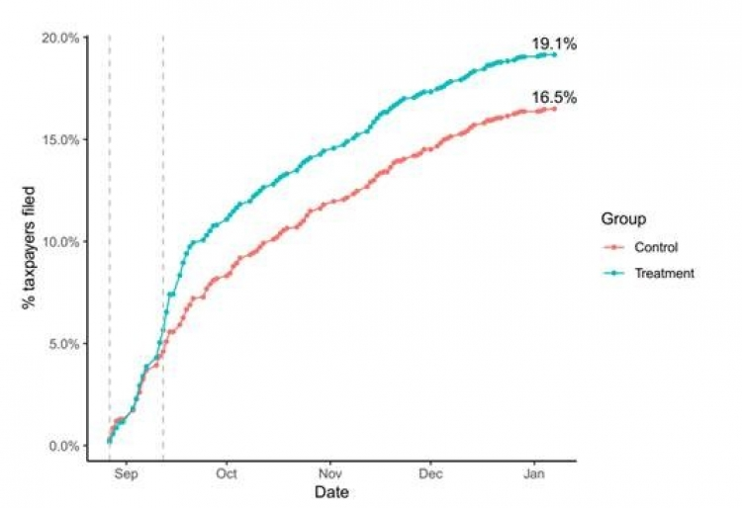
EARLY | Sending reminders before the deadline can be effective
Guatemala
Guatemalan Tax Authority (SAT) sent SMS reminders to general taxpayers but had not evaluated the impact
Some 30% of general taxpayers have overdue VAT declarations
Various SMS were sent at before/after the declaration deadline to 107,756 general taxpayers (with recorded mobile phone numbers) including both small companies and individuals
Messages sent before the deadline improved declaration rates by about 1%-point.
Other Experiences
Madagascar. Text reminders earned Madagascar a 32,800% ROI in collecting unpaid taxes. 15,885 late-income-tax filers and randomly assigned some of them to receive a series of messages reminding them to file a tax declaration and emphasizing various reasons to pay taxes (World Bank, 2019).
United Kingdom. HMRC sent taxpayers a link that took them directly to the tax form they needed to complete, as opposed to the web page containing the form, which increased response rates from 19% to 23% (BI Team, 2015)
BI Team, 2017
Does the choice of communication channel (e.g., telephone, mail, e-mail, and text) matter? To what extent does it depend on the segment and tax type?

Slide 10
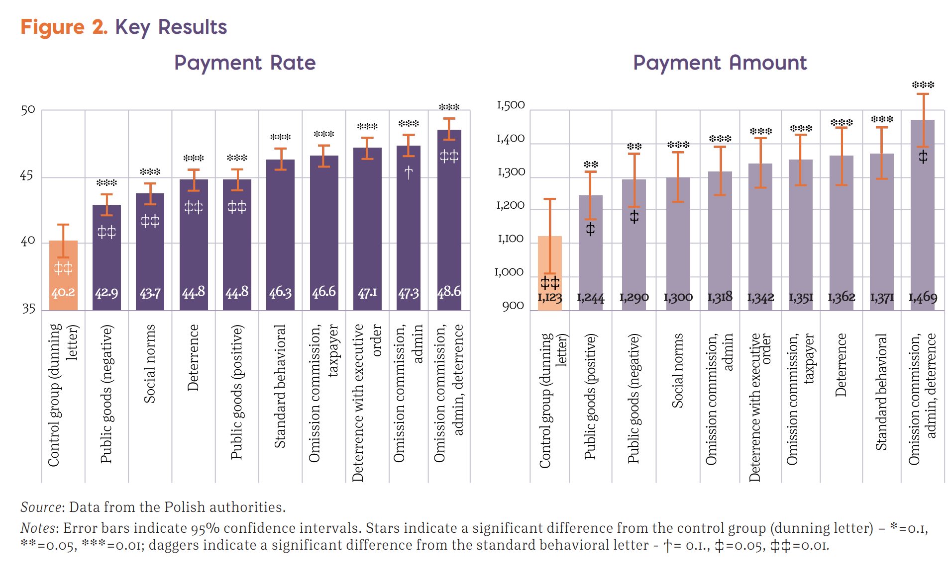
EARLY | Behavioral messages matter in tax collection
World Bank, 2017

Slide 11
EARLY | Establishing a system for reminders and communications
Need to establish a collaborative framework between debt collection department, on one hand, and the departments responsible for VAT, income tax, etc.
The debt collection starts when VAT is lodged, when tax return is handed in, etc.
It is important that when the registration is lodged, the payment should be made easy.
Reminders should be sent to the taxpayer – the longer time between lodgement and payment, the greater the risk
There are important differences between personal and corporate income tax payers

Slide 12
LATE | Arrears Management Strategies
Is it possible to increase withholding taxes on PIT to cover arrears? In Denmark automatically withhold up to about US$ 3,500.
Make it easier to pay outstanding taxes.
Contact taxpayers directly.
Pay in installments for those with temporary financial difficulties.
Withhold payments in taxpayers wages .
Engage Bailiffs for debt recovery
Take measures to seize assets
Declare bankruptcy (avoid further arrears)
Bankruptcy Quarantine
Easy Payment possibilities are essential
Country Experiences
Canada. The CRA has included a payment button right next to the amount of taxes owed, increasing the number of taxpayers voluntarily paying their debts.
Italy. The Equiclick mobile app made it easier for debtors to pay their debt through a responsive website. This initiative has made it significantly easier to make online payments. In 2017, Italy also introduced the Equipay Automated Teller Machine (ATM) System. This tool allows debtors to verify their tax balance and make a payment directly at an ATM. This payment option may be more convenient for those who may have more limited internet access.
Kenya. The KRA has launched a smartphone app making it possible to pay for Turnover Tax and Monthly Rental Income.
Russia. The FTS has consolidated the payment of different taxes so that the taxpayer can pay them in one go.
UK. HMRC can in response to arrears increase withholding taxes for individuals with annual earnings above GBP 30,000, also in the current year (not awaiting the next fiscal year).
Source: OECD, 2019 and Authors.

Slide 13
Dilemmas in debt recovery
Threshold for calculating outstanding taxes
The willing and able vs. the unwilling and unable
Finding the right measurement for the right taxpayers
Using datasets vs. civil rights
Using private sector debt collectors vs. legal certainty
Nina E. Olson, the taxpayer advocate at the Internal Revenue Service, has repeatedly complained that Congress is underfunding the agency. Andrew Harnik/Associated Press
“Private debt collectors cost the Internal Revenue Service $20 million in the last fiscal year, but brought in only $6.7 million in back taxes, the agency’s taxpayer advocate reported Wednesday. That was less than 1 percent of the amount assigned for collection.
private contractors in some cases were paid 25% commissions on collections that the I.R.S. made without their help, according to the annual report by Nina E. Olson, who heads the Taxpayer Advocate Service, an independent office within the I.R.S.”
New York Times, 2018

Slide 14
Maturity Model
Goal | ICT Support
1. Strategy is integrated across organization | Identify taxpayers for preventive action (those at risk)
2. Advanced IT used in selecting approaches for managing risky taxpayers | Use algorithms to segment taxpayers to enable tailored approaches
3. Personalized taxpayer engagement is supported by IT | Use IT to mass tailor communications / messages
4. Appropriate action taken on all arrears or taxpayers at risk of arrears | Monitor the portfolio of taxpayers at risk of arrears and in arrears
5. Enforcement tools are applied in individually and escalating | Establish IT systems to enable the automatic escalation of enforcement
6. Performance indicators are captured | Automatically capture performance indicators and identify outliers
7. Institutional accountability for action is assigned | The system includes the names of officials or unit responsible for action
8. Arrears officials are skilled | The systems allows for distilling lessons for use across the tax adm.
9. Arrears officials are performing | Staff performance for prevention and collection is assessed in IT
10. There is effective data sharing with arrears officials | Arrears officials received automatically relevant files for each taxpayer
11. Performance of the arrears collection can be readily assessed | Performance metrics are captured and can be tracked over time
Source: OECD, 2019 and Authors.

