Slide 1
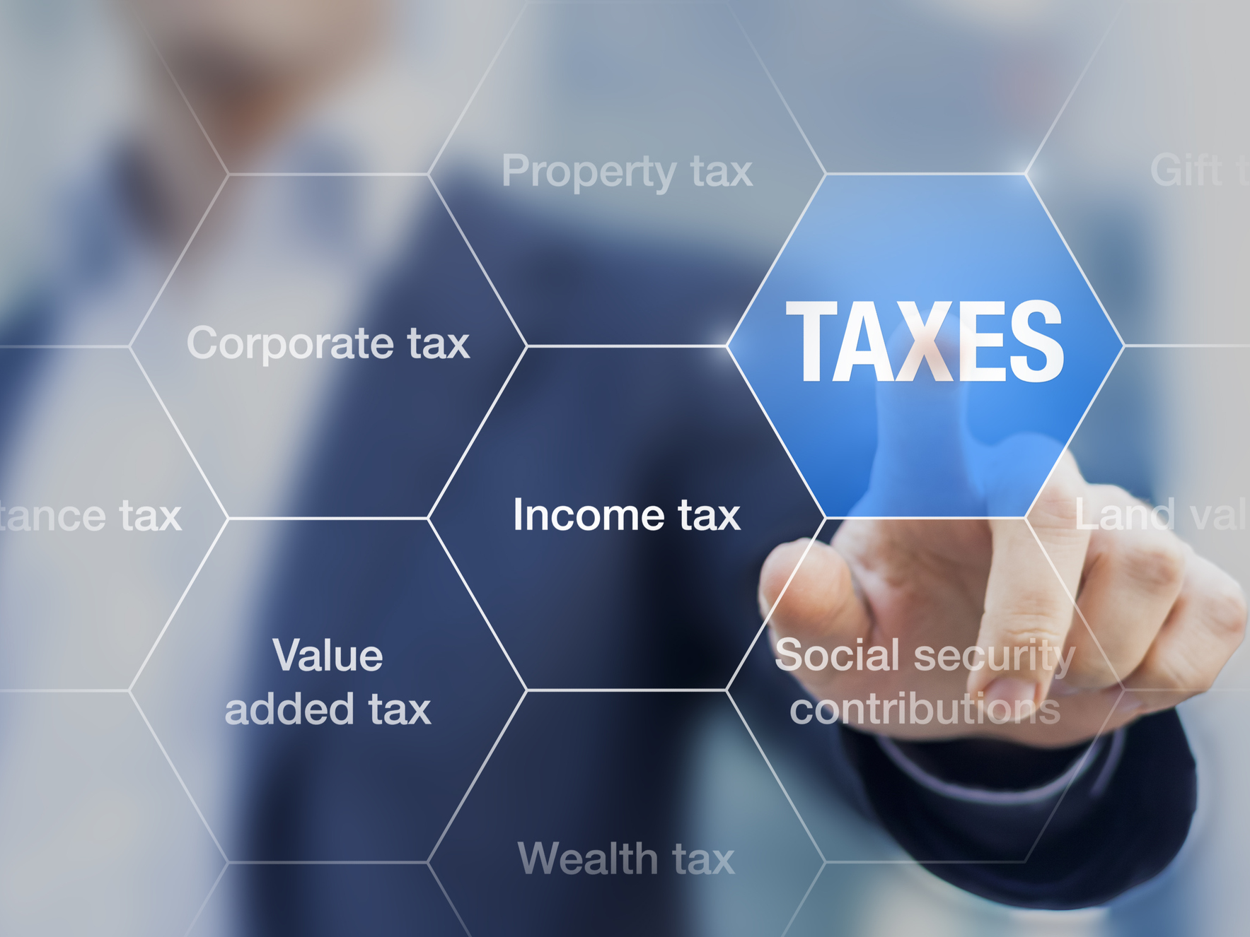
C O U R S E O V E R V I E W
Prosperity Collaborative
6|Acquiring Third Party Data
Anders Agerskov (World Bank) | 26 October 2021

Slide 2
Case | Leveraging Third Party Data in Emerging Market
Objective
Tax Administration requests support from the World Bank to increase the access to third party data
Approach
Understand what the government is really seeking, recognizing that what it asks for may not necessarily be what it needs
2

Slide 3
1|Access to Third Party Data
1. Client: We need help accessing to third party data, especially from utilities
WB: You have access to data from water and electricity companies, customs, banks, social security, the vehicle registry, etc. Where are you missing?
2. WB: What about getting access to detailed data about in- and outbound financial transactions?
Client: That will be difficult politically…
3. Client: Can you help strengthen the legal framework for data sharing?
WB: The digital development agency is developing a data interoperability framework and you have MoUs w/agencies.
Client: We don’t want to build on that framework.
4. WB: How often does third party data get updated?
5. WB: What restrictions are associated with third data. Can some of the data only be used for certain purposes (e.g., data from the police)?
Client: ?
Value Drivers | Baseline | Desired State
1. Access to all relevant data sets What third party datasets does [TAX ADM] have access to? Which additional datasets are needed? What legal provisions govern [TAX ADM]’s access to third party data (i.e., laws, regulations, and MoUs)? What provisions are included in the MoUs? What is the process for obtaining access to third-party data held by SOEs or private companies? How strong is the political support for expanded access to third-party data?
2. Access is automatic How regularly are third-party datasets accessed (on request, regularly, or automatic)? How are the data sets transferred to [TAX ADM]?
3. Access is secure and subsequent use is authorized What protocol is used to encrypt the transferred data? Has [TAX ADM] determined, whether there are any restrictions on the use of the third-party data? How has this been determined? How are legal, privacy and compliance issues assessed, particularly with respect to permitted use of data?
3

Slide 4
1|Access to Third Party Data
Value Drivers | Baseline | Desired State
4. Scope and quality of the third party data is understood How is information about the scope and completeness of records communicated to [TAX ADM], including which data sets may not be included in the transfer? What metadata accompanies the third-party data to help [TAX ADM] interpret the fields? Do third party data sets come with data dictionaries to help [TAX ADM] interpret the use of certain terms in the fields, e.g., the meaning of “vehicle”? Is semantic analysis of the data sets undertaken? What information is provided by the third-party to help [TAX ADM] assess data quality, e.g., the third-party’s own assessment of the completeness and reliability of the files? The legal and operational risks of using third-party data is well-understood?
5. Mechanisms exist for improving the data quality of third party data What protocols are used for updating the received information based on [TAX ADM] information (to avoid that the third-party data owner keeps sending information [TAX ADM] knows is (possibly) erroneous? Have [TAX ADM] and third-parties appointed focal points and established protocols to facilitate communication and cooperation? How well is this working?
6. Capacity for leveraging third party data is adequate Has the responsibility for the above value drivers been assigned within [TAX ADM]? Have performance standards for 1-5 been established? Has a control framework been defined to reduce activity level risks? How are management and internal audit assessing this area? Have adequate resources (human and monetary) been allocated to the task?
6. WB: What do third party providers tell you about the databases, what the fields mean, what is in the fields, and the quality of the data?
7. WB: When you correct or normalize data, how do handle the next update by the provider when the data you receive is “dirty” again?
4

Slide 5
2|Ingestion of Third-Party Data
Value Drivers | Baseline | Desired State
1. Third-party data is cleaned and normalized How do they address issues like data quality, normalization, etc.?
2. Third-party data is effectively matched Are tax identification numbers used in all third-party datasets to enable matching with [TAX ADM] records? (Which third party data sets do not include TINs?) Automatic Exchange of Information
3. Third-party data is integrated with existing data What protocols exist for integrating third-party datasets? Are all third-party data integrated in the taxpayer file to enable a 360-degree view – or do they require access to separate systems?
8. WB: What tools and processes do you use for data cleaning? Who does that?
5

Slide 6
3|Integration, Access, and Use of Third-Party Data
Value Drivers | Baseline | Desired State
A. Only relevant third party data is captured How does the [TAX ADM] determine what third-party data should be captured? To what extent are internal data users involved in decisions about third party data acquisition? Has an effort been made to analyze key decisions (e.g., when to open an audit) to determine, which data are most important? What use cases are driving the data acquisition? Is there a feedback loop from control outcomes (e.g., data most important for detection of non-compliance) to data capture?
B. Data is integrated in standard business applications Third party data forms part of a 360-degree taxpayer centric view of the tax file? Third party data where relevant is accessible in compliance, control, investigation, arbitration, and collection systems?
9. WB: What process do you have in place to ensure that you acquire the right third party data?
10. WB: Is the third party data integrated in your own systems or is it only available on stand alone systems?
6

