Slide 1
Executive Programme in Tax and Digital Transformation
Asian Development Bank, World Bank Group and VIA University College
Data quality
Presenter:
Tyson Fawcett
Senior Director – Data Management
Australian Taxation Office

Slide 2
Acknowledgements
Australian Taxation Office - Kyongho Min and Kelly Nicholson
World Bank – Various
University of Technology – Dr Asif Gill
New Zealand Inland Revenue Department – Doug Lambert
DAMA – Andrew Andrews
Alison Holt – acclaimed international expert in governance of data
SAS - John Stultz, Alexandre Negadi and Jeffrey Cooper

Slide 3
Data quality course outline
Module 1
Introduction to data quality
Module 2
Procedures, processes and practices in data quality
Module 3
Benefits, assessments and challenges

Slide 4
Module 1
Introduction to data quality

Slide 5
Opening activity
What does data quality mean to you and your organisation?
Notes:
Would people want their medical data to not be right
Data at the door v’s data in the door
Achieving and destruction when no longer reliant
Data quality is continuous
Data tools must have inteopribility

Slide 6
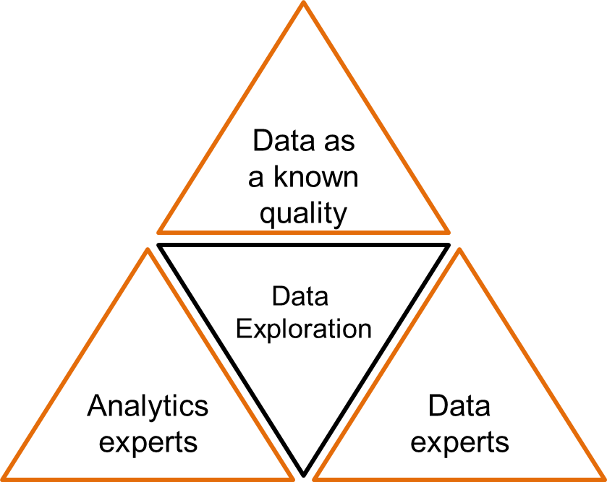
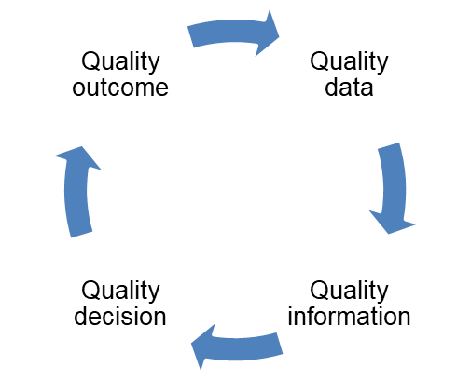
What is data quality?
the right data being available at the right time, for the right person, to the right user, to achieve the right outcome
consider the statement that the “weather is bad”, what does this really mean?
if someone states that they have poor quality data its difficult to interpret without describing the purpose of the data
Data quality refers to the state of data as it relates to it’s intended purpose. Generally, data will be considered high quality when it is fit for purpose.
The data triangle
The circle of
data quality

Slide 7
Data quality principles?
1. Consistent data quality management across the data lifecycle within business processes.
2. Data quality is measurable and assessed for fitness for purpose before use.
3. Data quality management will consider prevention of data errors in the first instance by considering the costs and benefits of root-cause remediation.
4. Data quality management will be objective and transparent, with data quality outcomes captured and made known to all data users.
5. Data quality is managed by dedicated roles that are responsible and accountable.

Slide 8
Data quality in a data driven organisation
not all oil is good oil and as such the need to collect ‘all data’ needs to be altered to collecting the ‘right data’.
right data collection requires the input and interactions across a number of strategic pillars which will be explored:
people/culture
process
procedures
data
technology
law/administration
“The journey of digital and being a data driven organisation is a marathon without a finish line”
The Data Avatar
When I am first born, I need someone to look after me. I am new and do not really know anything about myself or know what to do. There will be lots of people wanting to look at me and cuddle me and try and teach me things – but it is you that I trust.
I will grow and get bigger both mentally and physically, so I hope you will guide me in what is good and what is bad. If you feed garbage, then I will produce garbage. I will be needy and expensive to keep, but over time I will also bring great value to you.
Remember if you treat me well I will be faithful and trustworthy. You treat me kindly I will do whatever I can to make your life easy, simple, and fun. Treat me unkind and I will make your life frustrating.
I will make friends, and I am hoping that your guidance and direction will keep me safe, but sometimes I will meet others who will be different, some good some bad, and I can only hope that the time that you cared for me will make me stay true to my purpose in this world.
Thankyou

Slide 9
Data quality considerations
data is growing exponentially due to technology and the changing expectations of generational population.
challenge is how to effectively manage the quality of the data
technology solutions have driven an unprecedented rise in the cost of organisations in managing its data programs.
collecting data for an intended purpose is critical in managing increasing organisational costs.
Managing the collection of right data for a purpose should:
decrease in cost of architecture
decrease in cost related to process
decrease human costs uplifting data maybe for use
Key data terms
Data: reinterpretable representation for information in a formalised manner suitable for communication, interpretation, or processing.
Information: is a term used that suggests a richness of meaning and typically takes an end user view of the value of data to an organisation.
Knowledge: suggests an understanding acquired through experience or education that enhances the information.

Slide 10
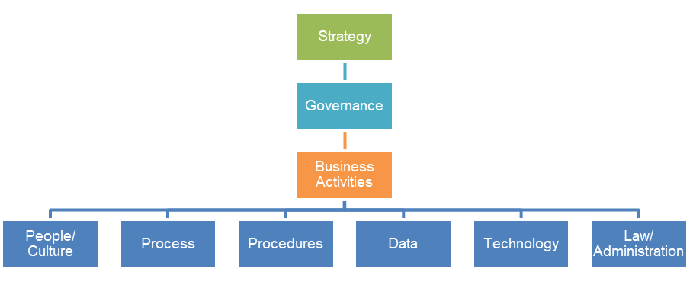
Data in business
Any use of data should support the strategy of an organisation. There should be governance in place to ensure that senior management control and monitor the activity.
The top level questions of importance
People/Culture | Does my organisation have a strategy that makes reference to digitalisation and the use of data to drive insight to customers?
Process | Who are the dedicated enabling areas in an organisation designed to bring this to life?
Procedures | Does procedures and practices support the optimised approach to digital and the use of data in the organisation
Data | Is data considered an asset, and an understanding that extends to its treatment as an asset
Technology | Is the technology architecture modern and smart to pivot to support the organisations approach to data
Law/Administration | Do laws and administrative practices exist for the collection and use of data to assist citizens to meet obligations

Slide 11
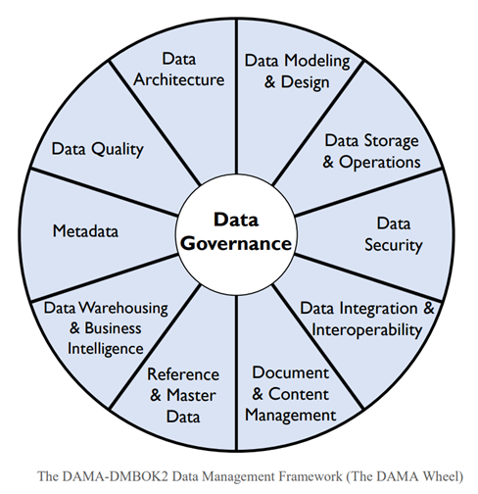
What is data quality management?
ISO 8000-2 defines data quality management as:
Coordinated activities to direct and control an organisation with regard to data quality.
Its greater than managing just quality processes – its:
consideration of why data quality is poor and identifying root cause issues
trying to achieve the state of optimised data rather than an ideal state of data perfection
Data ownership
Effective data owners are those that determine the appropriateness of their data for the purpose.
Five key principles when considering your approach to data quality management:
Process Centric Approach
Aim for a marathon to data quality maturity
Data specifications
Roles and responsibilities
Data quality as a lead

Slide 12
Data quality management features and benefits
Features | Benefits
The organization is aware of the importance of data quality and it is built into all business processes, planning documents and resource decisions. | Quality management decisions are visible and transparent.
Data quality policy and supporting processes and procedures are implemented, communicated and followed by all staff. | Consistent data quality management with evidenced based and defendable outcomes.
Data quality is a core component of the data lifecycle and is measured and monitored for all key data assets. | Data used is always fit for purpose.
Metadata includes data quality which provides transparency and end-user access to data quality metrics. | The quality of data is transparent and metrics reusable.
Data quality monitoring and error correction is automated whenever possible. | Data quality management is natural, quick, easy and cheap.
Data quality policy is enforced and tested to ensure requirements are met. | Confidence and trust are established when data quality is assured.

Slide 13
Data quality in the data lifecycle
The benefits of good data quality management will be delivered in distinct phases throughout the data lifecycle
It is important to identify when the data quality process begins in the data lifecycle
Consider unique characteristics and/or end to end data flows that vary
Ensure business needs are met when selecting when to begin the data quality process.

Slide 14
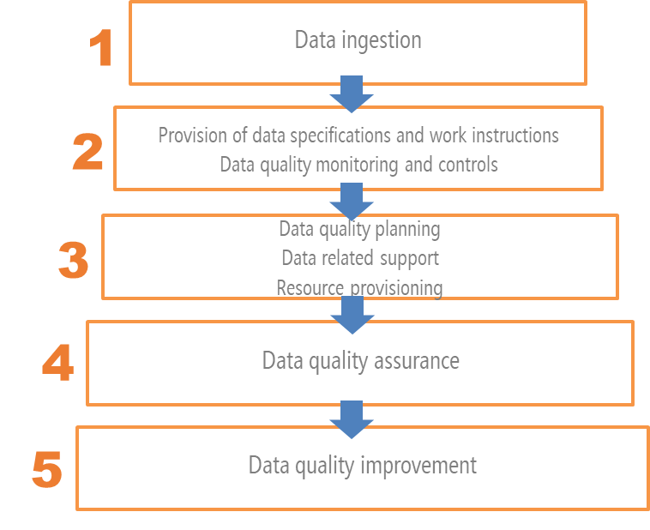
Data quality capability levels
Organisations require a comprehensive data quality capability.
People often refer to a five-level progressive model for data quality management.
It is when all five levels are implemented that one can then say they have a framework that meets data quality management as specified by ISO 8000-61

Slide 15
Module 1: Activity 1.1
Explain the importance of data quality
Identify 4 features and benefits of data quality management
At what stage in the data life cycle should we consider data quality?

Slide 16
Module 2
Procedures, process and practices in data quality

Slide 17
Data quality framework
A consistent end to end data quality management solution
Practical components make it operational and effective.
Benefits of a data quality framework:
Consistent end to end data quality management
Ensures data is only used when it is fit for purpose
Foundation to mature the data quality capability and organisations culture
Roles and responsibilities are clearly defined
ISO 8000-61

Slide 18
Data quality dimensions - measurable features or characteristics of data used to determine data quality.
1. Accuracy | the degree to which the data correctly represents the ‘real-life’ entities they model
2. Completeness | the degree to which all required data attributes are present and all expected records are present
3. Consistency | the degree to which data values are consistently represented within a data set, between data sets and consistently associated across data sets.
4. Timeliness | the degree to which the data is the most up to date version of the information
5. Uniqueness | no entity or record exists more than once within the dataset, where a key value relates to each unique entity, and only that specific entity, within the dataset
6. Validity | the degree to which data values are consistent with a defined domain of values e.g. data type, format, precision of expected values, or a specific length of time between data generation
7. Integrity | the degree to which all references in one table match the values in another table
8. Reasonableness | the degree to which there is a likely value based on history or other environmental data
9. Currency | the degree to which the data is current with the real world given likely time related changes
10. Precision | the degree to which the level of detail in the data element is relevant to the purpose

Slide 19
Dimension indicators and business rules
Each dimension requires indicators and business rules to measure the quality of data.
Indicators describe the relevance of the data quality dimension to the purpose.
Business rules define the data quality measurement metrics used to support each indicator. They describe the calculations required to determine the dimension score.
Note that there may be more than one indictor or business rule for each dimension in order to calculate data quality score and grade.
For example
Completeness - the degree to which all required data attributes are present and all expected records are present
Indicator = I require name address and data of birth in order to identity match the data
Business rule = count the records that contain the attributes first_name, surname, address and DOB and express as the percentage of all records in the data asset.

Slide 20
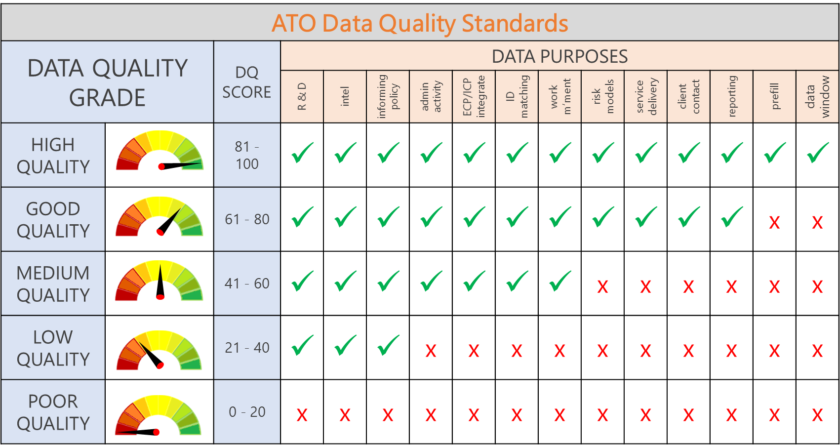
Data quality weightings, grades & standards
The data quality grade is determined using the data quality score and standards provide permittable use of data
dimensions can be weighted in accordance with their relevance to the data purpose
allows the data quality score to best reflect the true data quality grade to determine if the data is fit for purpose
Relevance scale | Weighting
Very high | 1.00
High | 0.80
Neutral | 0.60
Low | 0.40
Very Low | 0.20

Slide 21
Data quality matrix - a self-service template to guide users to measure the quality of data > supports consistent data quality management > auto features are efficient > re-usable
resource intensive at the beginning but efficiencies gained when data quality is monitored and can be re-used by others

Slide 22
Data quality tools
the processes and technologies for identifying, understanding and correcting flaws in data
a broad range of functions and capabilities, which include data cleansing, profiling, parsing, monitoring, and enrichment.
Common functionalities in a data quality tool including:
Data profiling
Data elimination
Data transformation
Data standardization
Data harmonization
When selecting a data quality tool consider:
Price – is it one off, enduring, does it include upgrades, and ad on;
Support – onsite, offsite support, training etc;
Usability – including IT users, analytics, and business users;
Scalability – with increasing data ingestion will the tool evolve with that expansion;
Features – auditing capabilities, integration with existing IT software and hardware, on previse v’s cloud, metadata support etc

Slide 23
Module 2: Activity 2.1
List the data quality dimensions.
Select two dimensions and write one indicator and one business rule for each.
List your organisations data uses and identify the data quality grade that should be required before data is used for that purpose.

Slide 24
Module 3
Benefits, assessments and challenges

Slide 25
Benefits of data quality management
In Philip B Crosby’s book Quality is free (1979) is said:
Data quality is free. It is not a gift… What cost money are the unquality things – all the actions that involve not getting data quality right the first time and all the actions to correct these data quality issues…
Benefits will include:
Organisational efficiencies and costs savings
A more robust risk management approach as defined by better quality data
The ability to explore better and new opportunities
Preparing for data quality
Preparatory activities include:
Agreeing the vision, goals and objectives of implementation
Stakeholder identification and engagements
Executive support
Planning & budget and resourcing agreement
Make data quality coherent with drivers of change
Include data quality in organisational planning documents;
Visionary leaders with an understanding of its investment and benefits;
Skilled capability;
Key internal and external stakeholder groups that understand the importance of data quality.

Slide 26
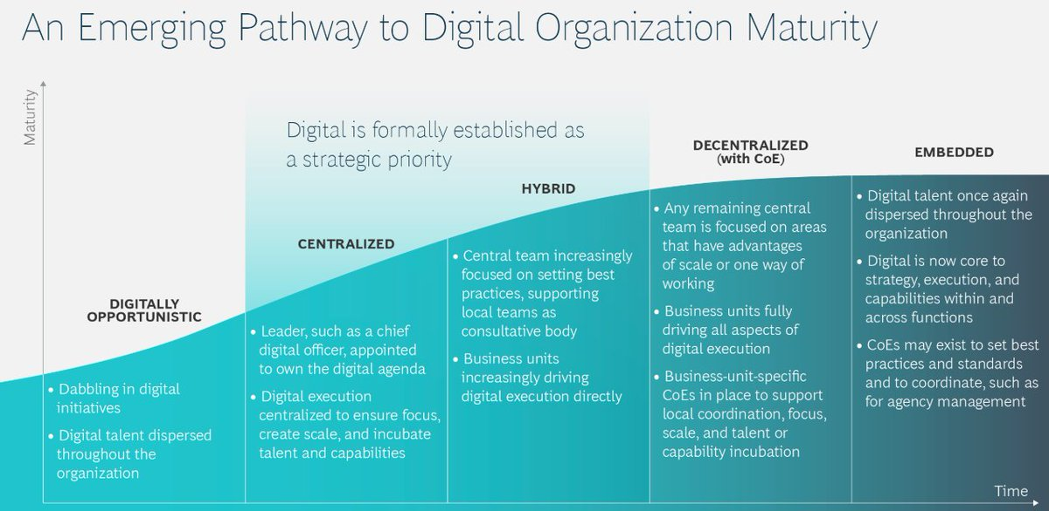
Enterprise maturity assessments
Digital maturity assessment examples
Essentially the most common themes used in a digital maturity assessment are:
Governance and leadership;
People and culture;
Capacity and capability
Innovation
Technology
Scales to measure each theme include:
Level 1: Minimal;
Level 2: Informal and reactive;
Level 3: Transitional
Level 4: Customer Driven;
Level 5: Transformative

Slide 27
Data quality maturity range
Looks to assess across several layers, assessing components:
Data Quality Expectations - defining data quality expectations often is tied to the convergence of understanding between the information specialists and their business clients.
Dimensions of Data Quality - the ability to predict where data quality becomes critical to achieving business
Policies - the approach to managing conformance
Procedures - high-performance organization lies in its well-defined processes and protocols for ensuring data quality
Governance – is mapped program to the different levels of the maturity model;
Standards - is a key to coordinated activities, and the maturity of the organization is reflected in the way it defines and implements data standards;
Technology - the focus on data quality improvement transitions from acquiring tools to assembling a service-oriented approach.
For example: Data Quality Expectations - component maturity description
Initial | Data quality activity is reactive No capability for identifying data quality expectations No data quality expectations have been documented
Repeatable | Limited anticipation of certain data issues Expectations associated with intrinsic dimensions of data quality data values can be articulated Simple errors are identified and reported
Defined | Dimensions of data quality are identified and documented Expectations associated with dimensions of data quality associated with data values, formats, and semantics can be articulated using data quality rules Capability for validation of data using defined data quality rules Methods for assessing business impact explored
Managed | Data validity is inspected and monitored in process Business impact analysis of data flaws is common Results of impact analysis factored into prioritization of managing expectation conformance Data quality assessments of data sets performed on cyclic schedule
Optimized | Data quality benchmarks defined Observance of data quality expectations tied to individual performance targets Industry proficiency levels are used for anticipating and setting improvement goals Controls for data validation integrated into business processes

Slide 28
Data quality management maturity assessment
 | Questions to consider | Novice | Foundation | Advanced | Leading | Exemplar
People/ Culture | What is the level of awareness of DQ in your organization? How important is DQ to your organisations? Does your organization have roles dedicated to DQ management? | The organisation has little awareness of the importance of data quality. Data leaders cannot identify the overall quality of ATO data at any given point in time. | There is awareness of the importance of data quality in parts of the ATO Dedicated DQ operational roles are established for ongoing BAU DQ management. | DQ is a core KPI - reported regularly and consistently. Leaders can identify the quality of data at any time. | Data quality is an integral part of the overall business strategy and planning processes. | The continuous attempt to improve the data quality capability.
Law/ Administration | Does your organisational laws and administration allow data to be corrected for a variety of data types | No changes can be made | No changes can be made and data can only be changed by the source | Partial changes can be made by way of verified data sources | Data can be corrected and changed and notifies the source of the changes as permitted by law | Data correct and shared with permission by the source to other organisations

Slide 29
Data quality management maturity assessment
 | Questions to consider | Novice | Foundation | Advanced | Leading | Exemplar
Process | Are DQ issues addressed downstream by multiple data users? Is DQ built into business processes as BAU? Do you consider the quality of data before using it in your organisation? Does your organisation have KPI’s linked to the improvement of DQ? Are any DQ measurements/assessments checked for accuracy? Does your data governance function include DQ? Does your enterprise risk management include DQ risks? Is your DQ process automated where applicable? | DQ issues are addressed downstream multiple times by multiple users – duplication of effort Data that is of poor quality is not prohibited from use Data quality risks are not identified measured or monitored consistently across the ATO. | Data quality policy is implemented, dictating how and when data quality processes are used and managed. The DQ process is manual at first with automation developing for DQ measurement, DQ reporting and DQ uplifting Data improvements will be funded to address root cause only where the long-term benefit outweighs the cost. | Data quality operations is BAU Data quality policy is established as a core component of the data lifecycle. Data quality policy is enforced and tested to ensure requirements are met. DQ risks are identified, measured, managed and monitored as regular part of business management. | Data quality monitoring and error correction is well organised and largely automated. DQ metrics are captured in metadata in an enterprise data catalogue Data quality policy is enforced and tested to ensure requirements are met - governance. | The continuous attempt to improve data quality management.

Slide 30
Data quality management maturity assessment
 | Questions to consider | Novice | Foundation | Advanced | Leading | Exemplar
Procedures | Does your organisation only consider DQ when issues arise? Does your organisation have DQ policy, process and procedures? Is DQ measured or monitored regularly? Is DQ measured consistently across your organisation? Is DQ quantitatively managed? Are DQ procedures easy for staff to follow? Are DQ results and decisions recorded and made transparent to data users? Does your enterprise metadata include DQ? | No strict rules or procedures for Data Management relating to data quality. Often data quality is reactive - only considered when data issues arise. DQ assessments are subjective, challengeable and ineffective for end to end lifecycle data management. Data documentation is generally limited, and quality is poor. | There is no systematic monitoring of the data quality, and error correction is usually carried out manually in an ad hoc manner. | Procedures are easy, natural | Data quality is quantitatively managed. A metadata environment has been instituted providing end-user access to data quality metrics. | The continuous attempt to improve data quality procedures.

Slide 31
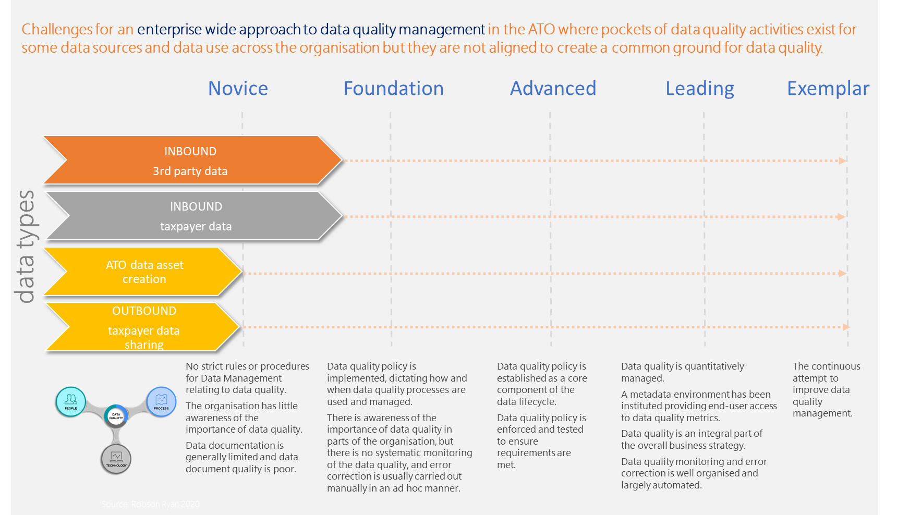
Data quality management maturity assessment
 | Questions to consider | Novice | Foundation | Advanced | Leading | Exemplar
Technology | Is your DQ process managed manually? Are any parts of the DQ process automated? For example, measure or improve. Does your organisation have technology that is dedicated to managing data quality? | No technology support DQ management | DQ technology is emerging but often not used consistently or effectively across the organisation to manage DQ | Data quality monitoring and error correction is automated whenever possible. DQ technology develops to automate DQ where applicable in the process. | DQ tools provide fully automated solutions in the DQ process | The continuous attempt to improve data quality tools and supporting technology
maturity may differ across the organisation based on the source and/or characteristics of the data

Slide 32
Challenges for data quality management
With many data stores across domains it can be difficult to align to a common standard
As data stores expand the process of standardisation becomes more difficult to align
Ownership and stewardship can be weak because of the unknown
Business processes are updated by different parts of the organisation
There can be many users of the data, with various understandings of the purpose of the data
Processes are not centralised to the data store or the source of truth
The diversity of data sources brings abundant data types and complex data structures and increases the difficulty of data integration
Data volume is tremendous, and it is difficult to judge data quality within a reasonable amount of time
Data change very fast and the “timeliness” of data is very short, which necessitates higher requirements for processing technology.
No unified and approved data quality standards
Data quality issues of the future
Challenges of data quality will be influenced by:
changing organisation structures
changing markets and supplier relationships
new legislation
changes to external data feeds or requirements
internal software changes
The single biggest risk in the future to data quality is the dilution of human knowledge in the process, procedure and practices of data quality with the illation of technology being the fix.
Solution - embed specialisation in data quality within organisation as a core to future data changes

Slide 33
Data quality and data ethics
Just because you can do something with data does not mean you should do it
The pillars of modern tax administration system are:
Stability
Efficiency
Equity
Simplicity
Competitiveness
Revenue adequacy
Data quality and data value
Key to data quality is the direct value that it generates from the data
promotes informed decision-making
business decisions impact bottom-line
decisions driven by poor data practices cost
lack of trust and confidence impacts
efficiency costs
improves customer experience
Using poor quality data and making decision impacts all these features.
The most significant impact is equity when you consider that some taxpayers could be selected for review by an administration in the absence of having quality data that considers the entire population.

Slide 34
Module 3: Activity 3.1
How would you rate your own organisations data quality knowledge?
What would be your assessment of your organisations data quality management maturity level?
What do you think will be some of the challenges in implementing a data quality framework in your organisation?

Slide 36
Data quality tools
the processes and technologies for identifying, understanding and correcting flaws in data
a broad range of functions and capabilities, which include data cleansing, profiling, parsing, monitoring, and enrichment.
Common functionalities in a data quality tool including:
Data profiling
Data elimination
Data transformation
Data standardization
Data harmonization
When selecting a data quality tool consider:
Price – is it one off, enduring, does it include upgrades, and ad on;
Support – onsite, offsite support, training etc;
Usability – including IT users, analytics, and business users;
Scalability – with increasing data ingestion will the tool evolve with that expansion;
Features – auditing capabilities, integration with existing IT software and hardware, on previse v’s cloud, metadata support etc

