Slide 1
Conducting Tax Audits and Monitoring Taxpayers
Executive Program in Tax and Digital Transformation | 29 March 2022

Slide 2
Purpose of the Lecture
Understanding the legal basis for audits
Prioritizing cases for audit
Understanding different types of audits
Accessing electronic books and records
Analyzing electronic books and records

Slide 3
LEGAL What are taxpayers’ legal obligations in connection with a tax audit?
Taxpayers are typically – but depending on the jurisdiction – legally required to:
Maintain books and records, which may also include Advance Pricing Agreements and the like
Maintain archived books and records for a period of time
Adhere to regulations governing electronic accounting systems
Provide the tax administration access to the books and records
Assist in some fashion with the tax administration’s audit
These provisions are typically contained in the tax code or company law, with access further elaborated in case law

Slide 4
LEGAL What type of information must taxpayers keep?
Source: UK Government, Accessed 2022

Slide 5
LEGAL What information is typically “off limits” to tax auditors?
Strategy papers
Expert reports
Research and development related papers
Can tax officials search employee emails and document filing systems?
What about legal opinions from in-house or external counsel?
Papers from the in-house tax unit?

Slide 6
LEGAL Political and policy implications
Lessons learned in Denmark
There was a large public discourse about what data is extracted and how it is used
A misdirected discussion as it was more about IT forensics and the ability to mirror data than E-audit
Conclusion : The Danish tax legislation does not require to hand in accounting information digitally. Instead, if accounting or relevant information is kept online, the business owner can decide to provide the material in a way he/she sees fit. So it can come in pdf, vsf, or other file formats.
Should the freedom to decide over the format be given to the taxpayer?
What types of formats should be accepted?

Slide 7
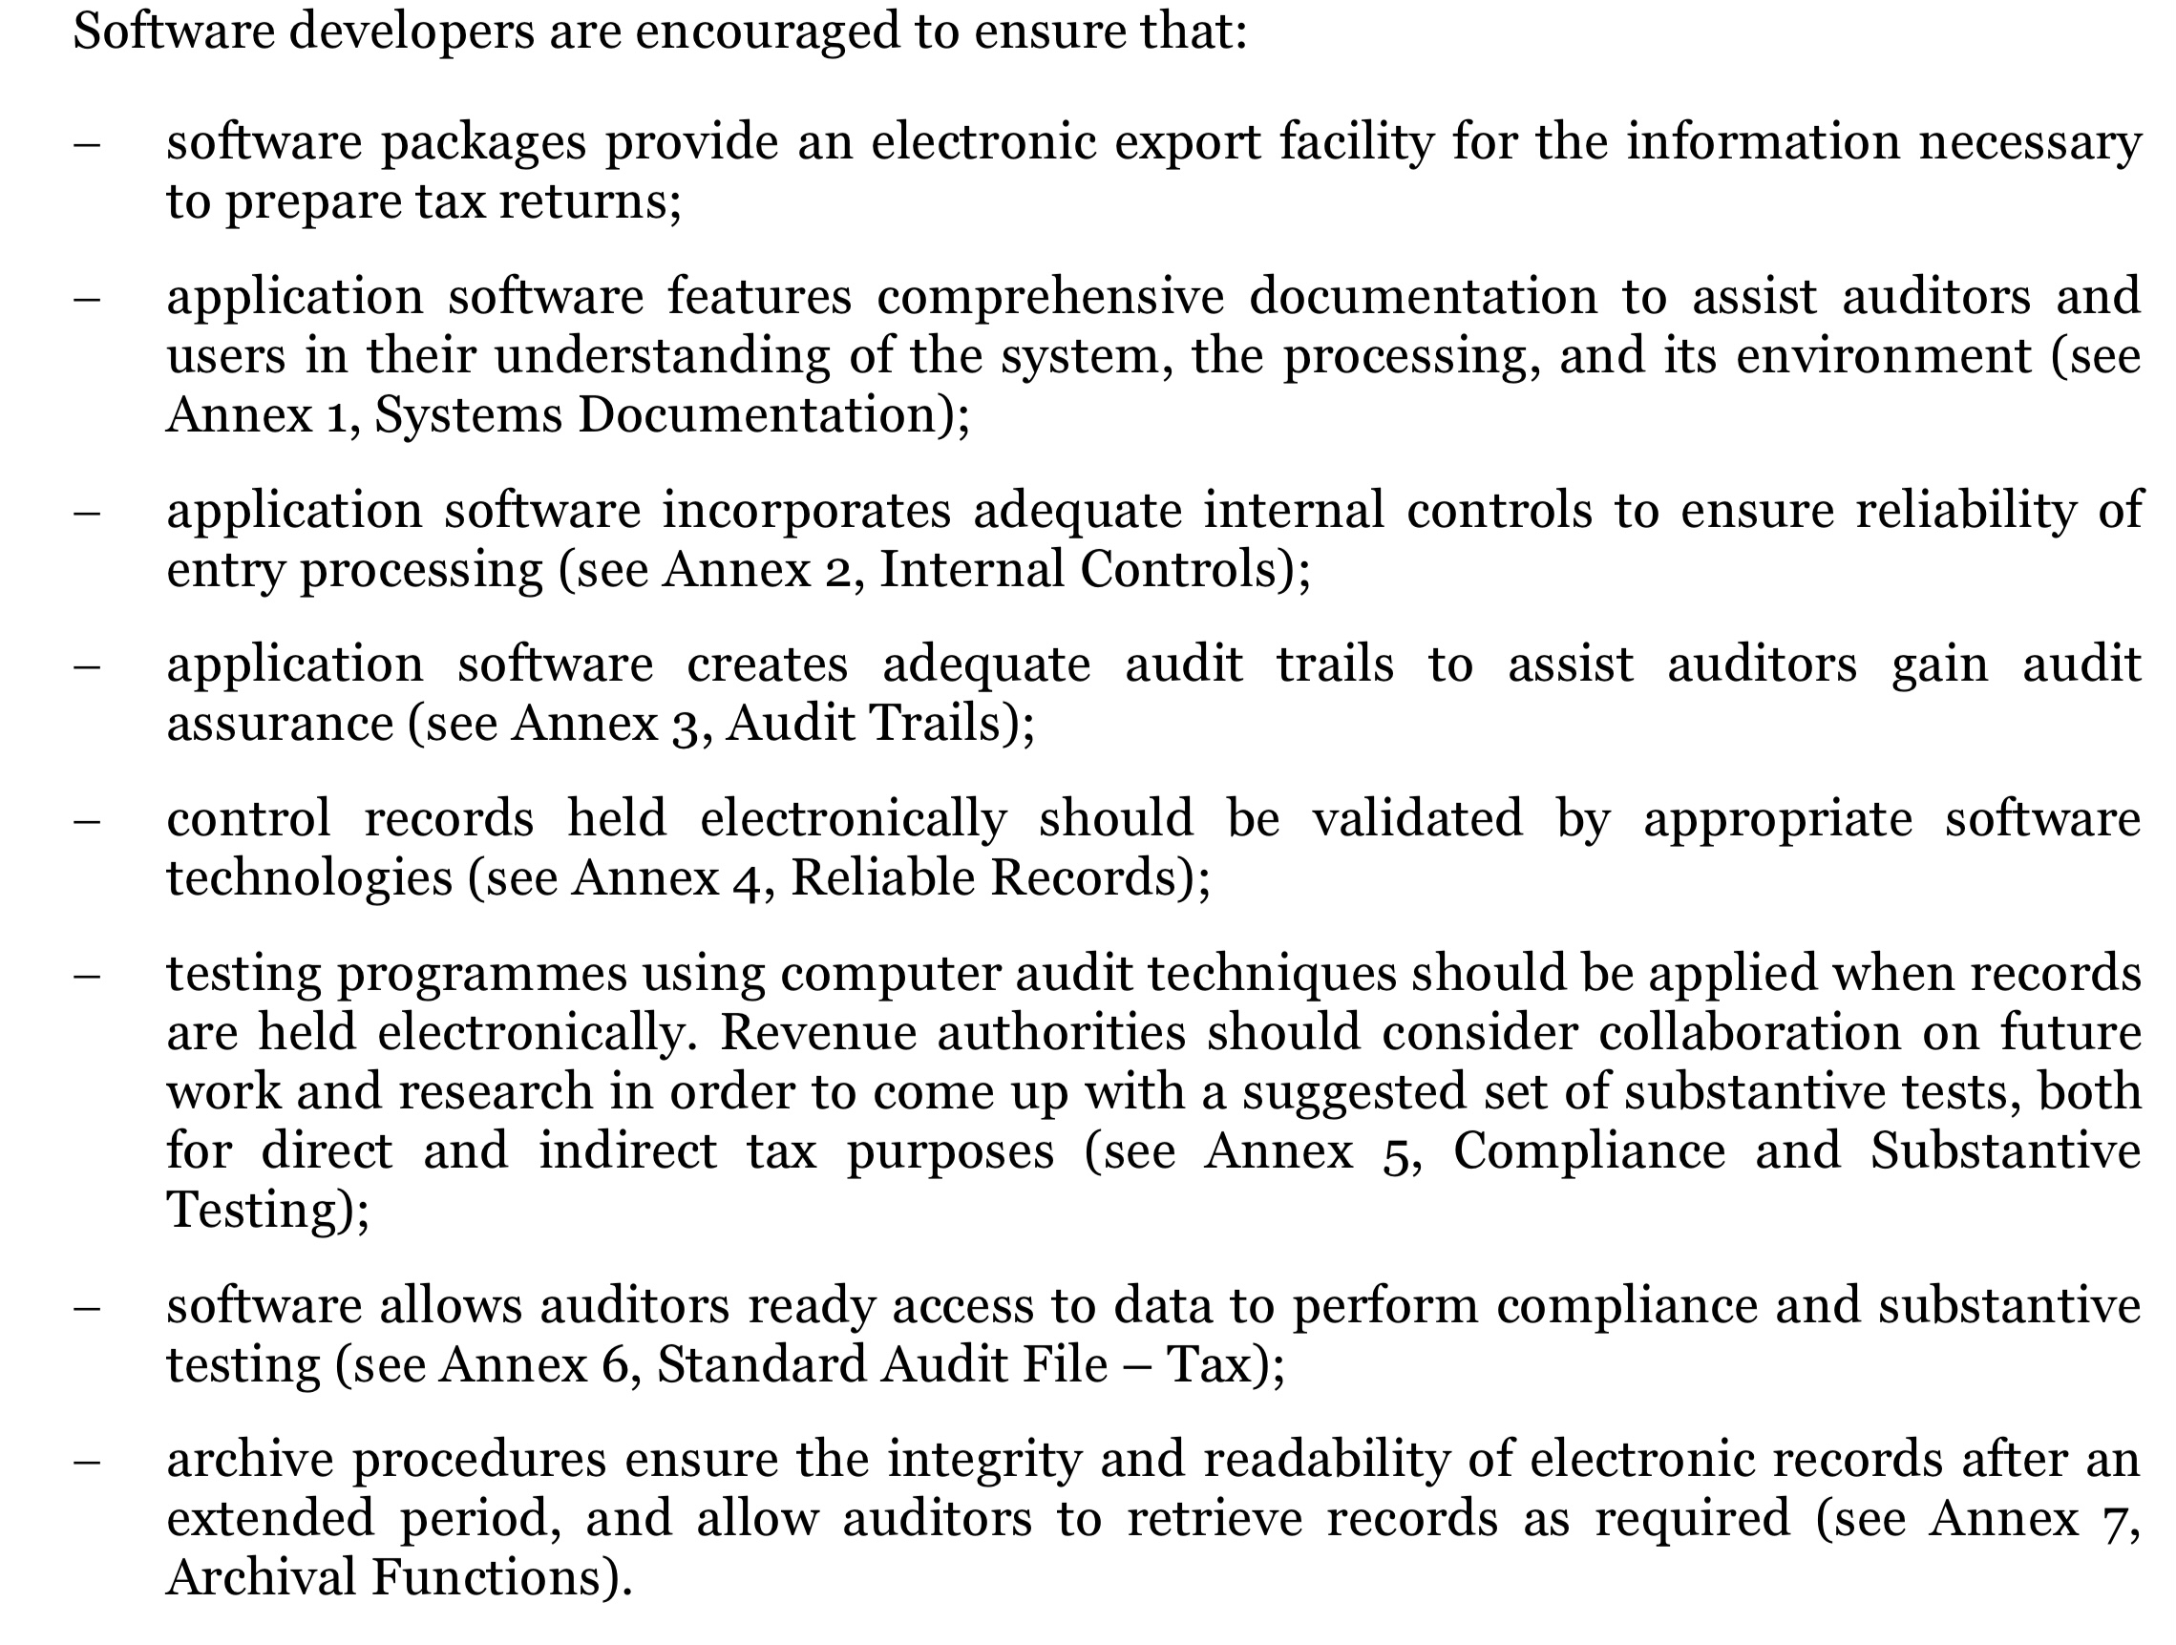
LEGAL Accounting Software Must Meeting Certain Requirements
Source: OECD, 2005
Notes:
CONTROLS TO ENSURE RELIABILITY
• Access controls to ensure that only authorized users can access and process data according to the permissions given.
• Data capture controls to ensure that the right data gets into the system
• Processing controls to ensure that the data remains correct throughout processing
• Standing data controls to ensure that criteria used to process the data are correct
• Security controls that maintain the integrity of the processed data
• Output controls to ensure that system output is in the correct format and that the recipient undertakes any required action

Slide 8
LEGAL POS Systems Can Pose a Risk of Electronic Sales Suppression
Software can be loaded onto the POS that eliminates a set of transactions, typically cash, in order to reduce the tax liability
A USB key can be used to perform the deletion – or it can be performed by an expert remotely (“Software as a Service, SaaS”)
The software may be “sold” along with the POS as an extra “feature” but can also be loaded onto certain POS systems later
Red flags of sales suppression include: (i) lower than usual amount of cash transactions; (ii) discrepancies between input (e.g., pizza boxes bought) and output (e.g., pizzas sold); and (iii) sales increase when the owner is out of town (or don’t decline when he is out during the vacation season), indicating that he and not his staff are running the zapper
Electronic sales suppression is a recurrent risk even in some high-income countries
Consequently, some governments have begun regulating POS systems
Source: OECD, 2013
Notes:
CONTROLS TO ENSURE RELIABILITY
• Access controls to ensure that only authorized users can access and process data according to the permissions given.
• Data capture controls to ensure that the right data gets into the system
• Processing controls to ensure that the data remains correct throughout processing
• Standing data controls to ensure that criteria used to process the data are correct
• Security controls that maintain the integrity of the processed data
• Output controls to ensure that system output is in the correct format and that the recipient undertakes any required action

Slide 9
LEGAL POS Systems May Be Subject to Regulation
Test vendor POS systems to create list of approved systems, certifying inter alia that systems are tamper proof and able to print sales eJournals
Require that businesses apply for using POS systems, disclosing name and serial number of equipment, names of suppliers and repair workshops, etc.
Mandate that businesses maintain a valid POS permit
Require a certificate of non-tampering in connection with repairs and modifications
Prohibit resetting POS serial numbers and require the disabling of “training mode”
Penalize breaches of POS regulations (e.g., monetary fines and prioritizing audits of non-compliant taxpayers)
Source: Philippines, Bureau of Internal Revenue (Accessed 2022), Philippines, Bureau of internal Revenue (2018), and Authors

Slide 10
PRIORITIZATION Selecting tax audit cases
Mismatch between self- and third-party reported data
Past non-compliance issues (e.g., adverse audit findings, late filing and payment, etc.)
Profit margins significantly below external benchmarks (see adjacent)
High net worth individual or large taxpayer (larger potential for revenue adjustments)
High-risk industry (e.g., construction and retail), owners/management, and address
Filed for (net) VAT returns
Significant change in revenue or profit compared to prior period for no obvious reason
Significantly lower profit or revenue compared to peers (e.g., hotels of a similar standard in close proximity)
Suspicious transaction Reports and the like
Industry
Code
Revenue
Markup
Different profit margins (% revenue)
Test effectiveness of individual factors against random audits
Source: German Federal Government in LHP Rechtsanwälte, Accessed 2022.

Slide 11
PRIORITIZATION Selecting tax audit cases
Test effectiveness of the various selection criteria
Objective is, e.g., maximizing tax adjustments (but could also be to obtain information necessary to close an operation involved in tax fraud, money laundering, terrorism financing, and organized crime, or identify non-compliant taxpayers)
The selection criteria should result in case openings that yield larger adjustments than randomized audits
Should take into account also costs of audits and compare similar types of audits
Develop appropriate targeting algorithms to inform case opening
Randomized audits serve an important role in assessing tax gaps and compliance levels
Risk-based audits need to take into account the different types of audits (e.g., off and on-site audits; VAR, PIT, CIT, and excise duties; etc.)
Triggers can be taxpayer segments (randomized), high-risk segments, transaction level red flags, predictive AI algorithm, and hybrid

Slide 12
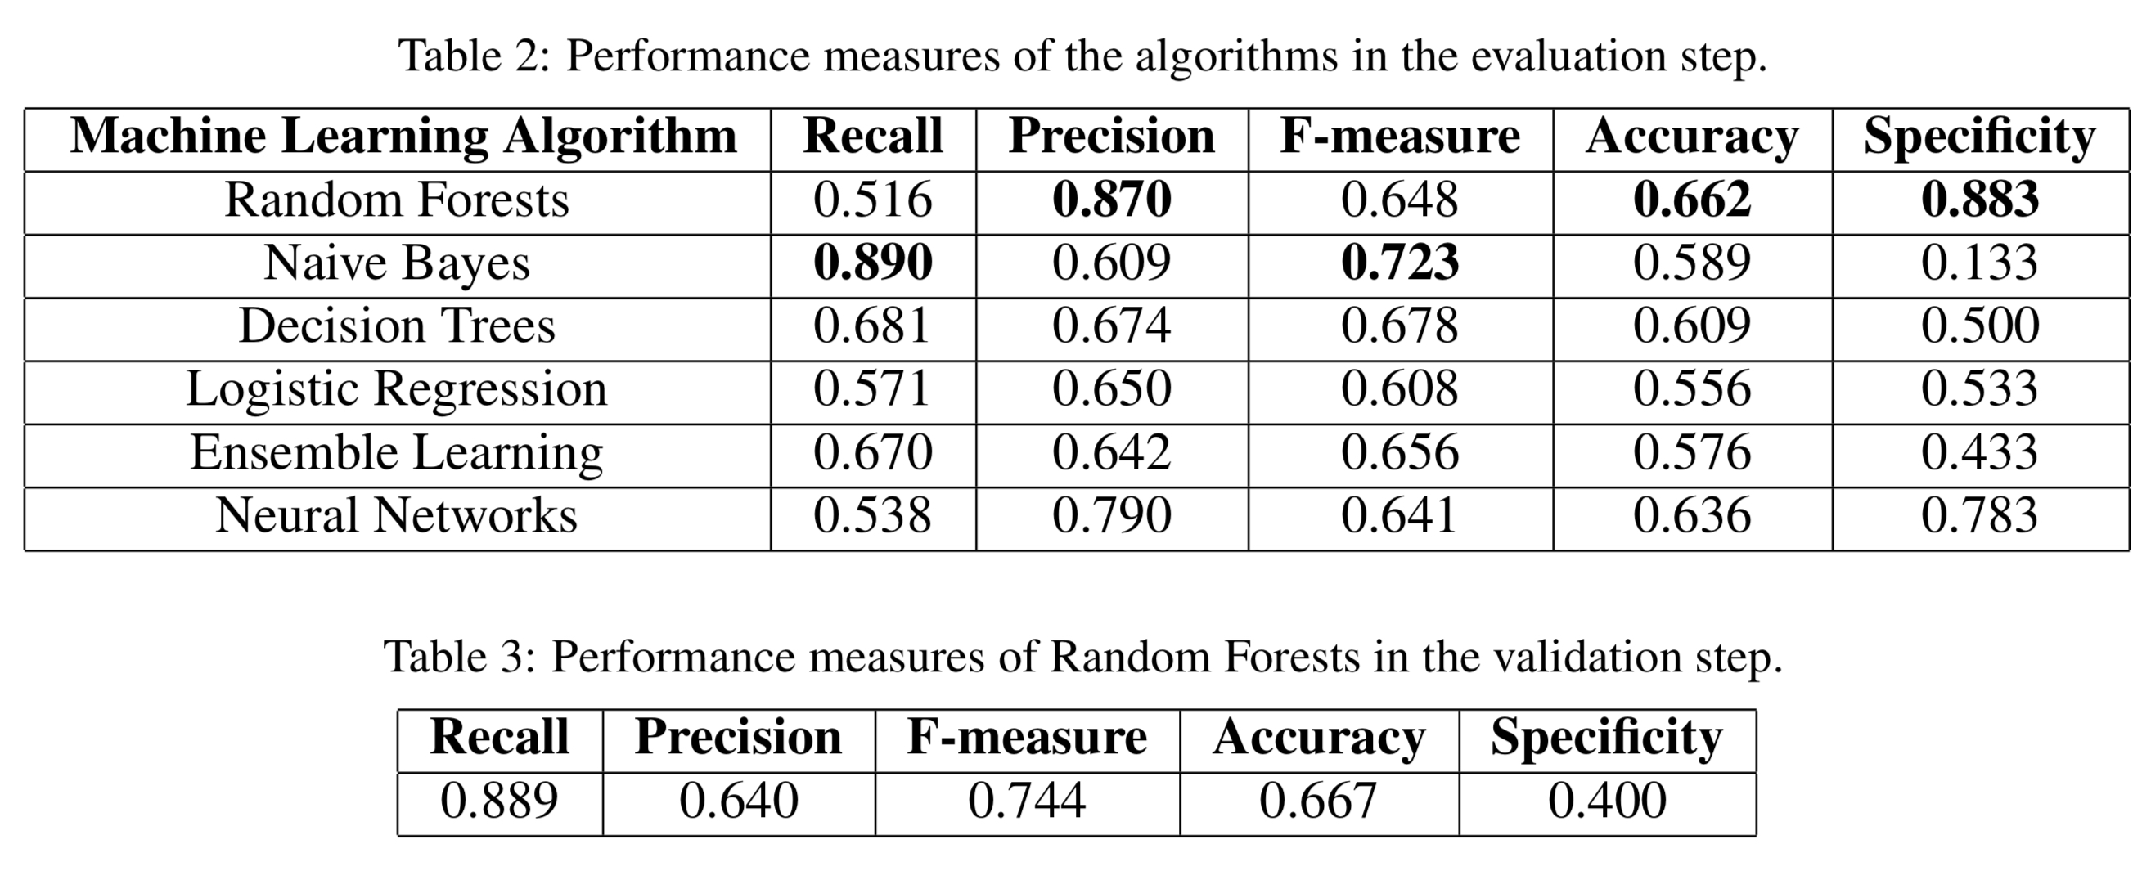
Case Example
PRIORITIZATION Selecting tax audit cases
Data
Data is collected from face-to-face fiscal audits and plans of action from 2016, 2017 and 2018 in Brazil
Data from 2016 and 2017 is used to train the model (151 cases of which 60% were tax crimes) – 2018 data is used for evaluation of the algorithm (66 cases of which 55% were tax crimes)
Analysis
The open source tool KNIME was used to explore data, apply AI algorithms, and test the results
Different algorithms were developed and evaluated against the 2016/2017 test data, see Table 2
Findings (Metrics)
Recall: Share of all tax crimes actually predicted
Precision: Share of the predicted tax crimes that were actually true
F-measure: The harmonic mean of recall and prevision
Accuracy: Share of the predicted tax crimes and non-crimes as a share of all cases
Specificity: Share of non-crimes actually predicted
Source: Ippolito and Lozano, 2020

Slide 13
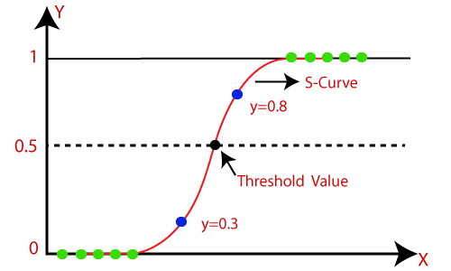
PRIORITIZATION Selecting tax audit cases – Logistic Regression

Slide 14
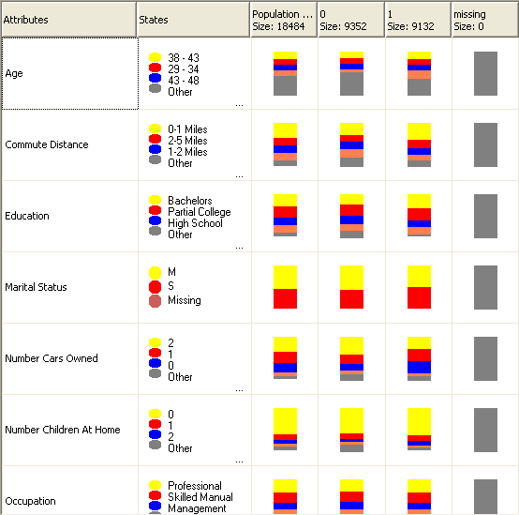
PRIORITIZATION Selecting tax audit cases – Naïve Bayesian
Predicting variables must be independent and categorized (not discrete values like income but income in different ranges)
Identifies categories that have different shares in two populations – e.g., in the example on the prior slide “tax crime” and “non-tax crime”
In the sample on the left, the predicting variable “Commute Distance” is very different for the result we are trying to predict (in this case 0=no sales; and 1=sales)
The Naïve Bayesian algorithm does not look at interaction effects on effects of each category individually

Slide 15
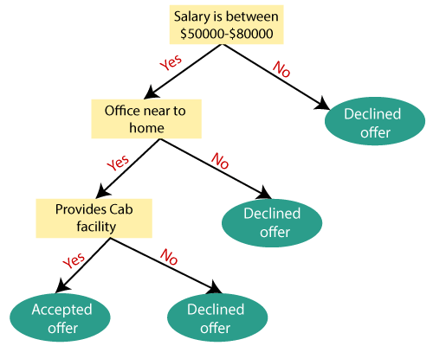
PRIORITIZATION Selecting tax audit cases – Decision Tree

Slide 16
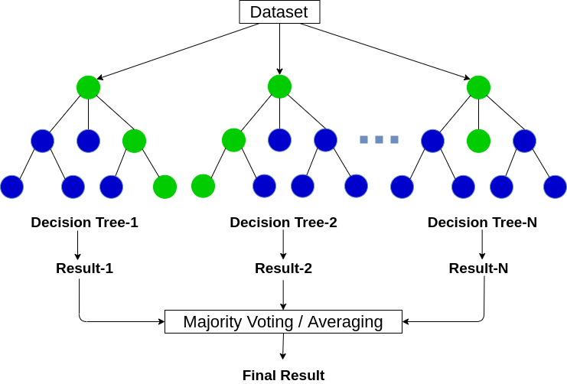
PRIORITIZATION Selecting tax audit cases – Random Forest

Slide 17
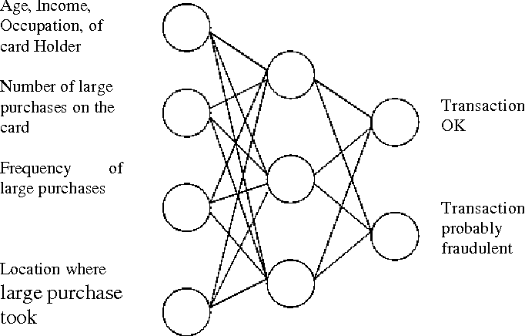
PRIORITIZATION Selecting tax audit cases – Neural Networks

Slide 18
AUDIT TYPES Understanding different types of audits
Different styles and approaches.
Basic e-audit: you get the same information electronically
A bit more sophisticated – it’s a way to audit specific accounts electronically
Way more sophisticated you will use ACL to mine extracted data to search for connections or irregularities
System based approach.
Cashiers registers they are virtual data hubs, and should be audited as such.
Pros and cons – what skills are needed in your organization to do the above actions.

Slide 19
ACCESSING Accessing Electronic Books and Records
How are accounting systems physically located in another jurisdiction (e.g., in a cloud or HQ) accessed?
Is the tax auditor free to use any tool to examine the corporate information systems?
Is the auditor required to agree with the company the searches being conducted on corporate databases?
How is encrypted information handled?
Can the auditor take the electronic data back to the tax administration?
What type of assistance must the company offer?

Slide 20
ANALYZING Analyzing Electronic Books and Records
First and foremost, you are looking to find the same things as in an normal audit
Which programs you use, depends on how you get data
Many different programs on the market
ACL is used in Denmark. Super Advanced spreadsheet
But in most cases we use AI or machine learning instead of programs to mine the datasets
Looking for anomalies

Slide 21
MONITORING Towards Monitoring of Taxpayers
Example from the Federal Tax Service of Russia (FTS)
Pilot offering large domestic and foreign companies on a pilot basis that they provide FTS real-time read access to their accounting system in exchange for earlier tax certainty (includes e.g., Unilever)
The taxpayer would share their own tax compliance risks with the FTS who on that basis would create an audit plan

