Slide 1
Digital Tax Administration Executive Program 2021
Establishing an appropriate data governance architecture.
Presenters: Tyson Fawcett
Senior Director Data Management
Australian Taxation Office
Veli Fikret
Senior Director Data Management
Australian Taxation Office

Slide 2
Activity
Why do you think Data Governance in Architecture is important ?

Slide 3
Introduction: What you should learn from this session
(i) defining roles and responsibilities for business processes, systems, and data;
(ii) mapping business processes, data flows, and databases; and
(iii) establishing a data concept model that ensures consistent use of concepts across all databases and fields as well as clearly defined data dictionaries.

Slide 4
Session 1 Setting the context Data Governance
Data Governance in the context of the Data Management
Lifecycle What Is it Data Governance?
Why Is it Important?
Data Governance in Practice?
Activity

Slide 5
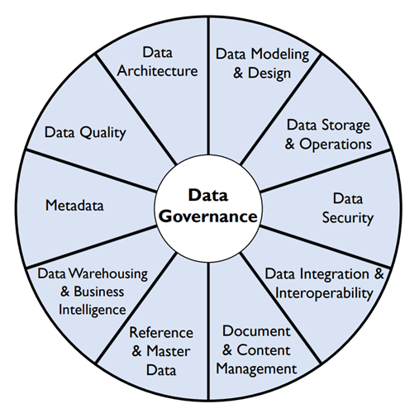
What Is Data Governance
Data governance is a collection of processes, roles, policies, standards, and metrics that ensure the effective and efficient use of information in enabling an organization to achieve its goals. ...
Data governance defines who can take what action, upon what data, in what situations, using what methods.
Data governance is a collection of processes, roles, policies, standards, and metrics that ensure the effective and efficient use of information in enabling an organization to achieve its goals. ...
Data governance defines who can take what action, upon what data, in what situations, using what methods.

Slide 6
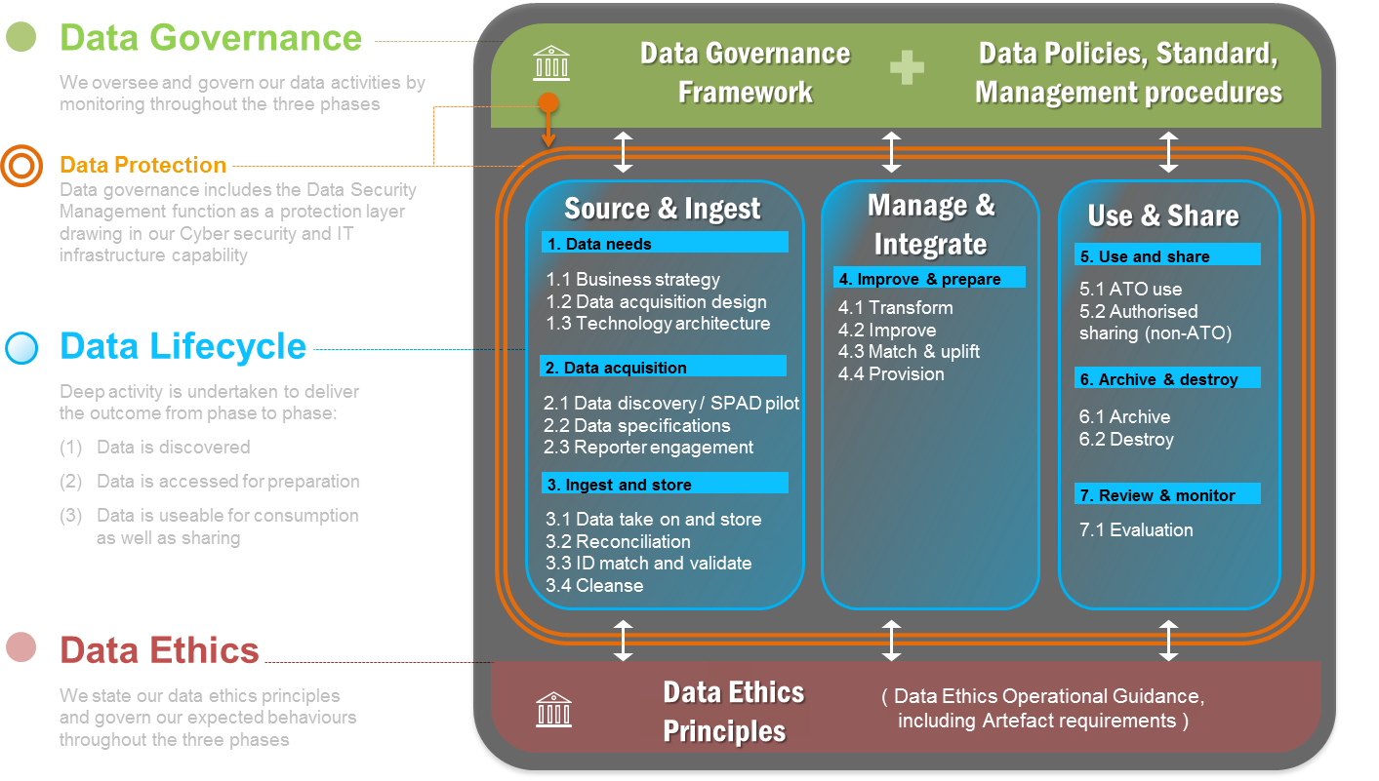
Data Management Model
End to end corporate roadmap to support delivery of all components of the Data Management Model

Slide 7
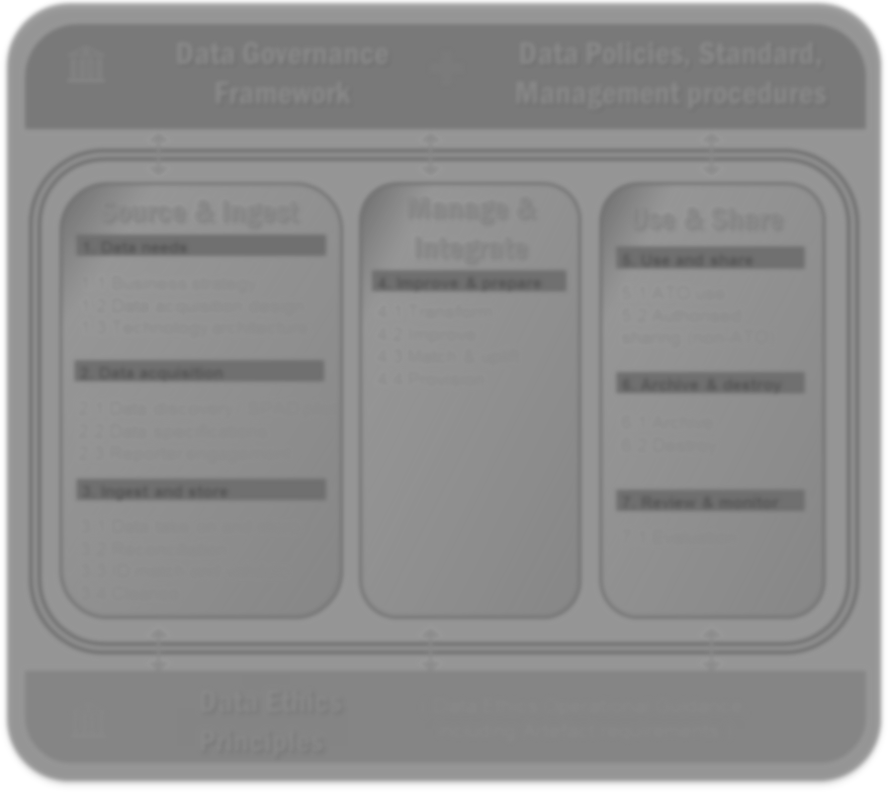
Data Management Strategy: interdependent components
Data Governance
We oversee and govern our data activities by monitoring throughout the three phases.
Data governance framework
Steering Committee
Data governance
assurance processes
Data stewards framework
Data Protection Data governance includes the Data Security Management function as a protection layer drawing in our Cyber security and IT infrastructure capability
Data management principles
Data catalogue
Data Lifecycle
Deep activity is undertaken to deliver the outcome from phase to phase:
Data is discovered
Data is accessed for preparation
Data is useable for consumption as well as sharing
Data is Valued
Source & Ingest
Manage & Integrate
Use & Share
Data stewards & data users
roles and responsibilities
aligned to corporate DM policy
Corporate data management policies, guidelines, procedures & standards aligned to data management principles for each phase of the data lifecycle
Data Ethics
We state our data ethics principles and govern our expected behaviours throughout the three phases
Data ethics principles
Data ethics guidelines - DEIA

Slide 8
Data Lifecycle Corporate Policy Development
A suite of integrated Corporate policy, guidelines and procedures.
initially the most resource intensive component of the Data Management Strategy (DMS) but the most critical
brings the Data Management Principles to life
provides data users and data stewards with defined corporate roles and responsibilities based on best practice
ultimately forms the basis for all data governance and assurance processes across an organisation
Public Sector Memoranda of Understanding
Records Management Policy and Guidelines CEI
Protective Security Policy Framework
Special Acquisition Data - CEI
EDH Policy
Data Asset Register
Data security policy
Source & Ingest
Data acquisition policy
Data store policy
Metadata policy
Data access policy
DWH/EDH Policy
Data quality policy
Manage & Integrate
Data matching protocols
Access to Taxation Records in the Possession of the Commissioner - CEI
Public Sector Memoranda of Understanding - CEI
Exchange of Information Unit - foreign tax authorities - procedures
Working with Treasury – CEI
Sharing electronic information guidelines and procedures
Records Management Policy and Guidelines CEI 2014/01/01
EDH Policy
Data provisioning
Data modelling policy
Risk model policy
Use & Share
AI Algorithm policy
Data share policy
Data retention policy

Slide 9
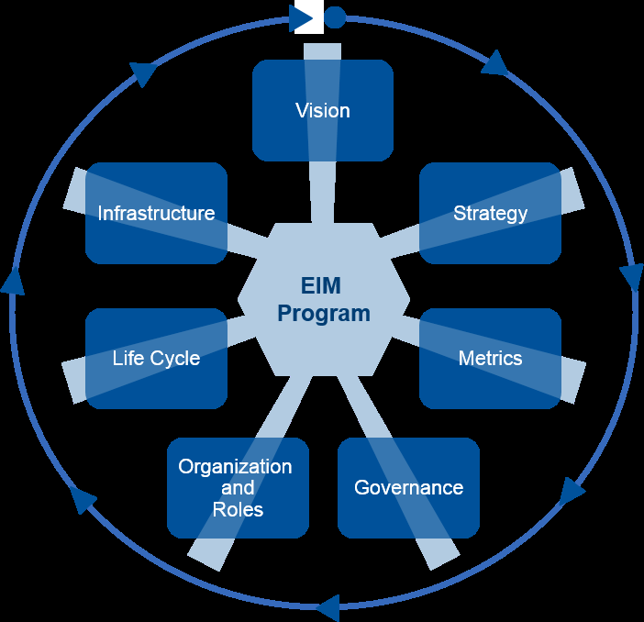
Gartner Enterprise Information Management (EIM) Building Blocks
The building blocks to achieve a strong EIM program. Using the Gartner maturity model will help data and analytics leaders advocate EIM principles and resources within their organization.
A Data Management Strategy can provide the roadmap for delivering and maturing EIM building blocks

Slide 10
Gartner's EIM Maturity Model: Strategy
Data and analytics leaders must define an information strategy that provides the long-term or ongoing plan for realizing this EIM vision. An EIM strategy needs three main components:
a commitment from the enterprise;
a roadmap for EIM;
a plan for structures to execute the strategy.
Strategy | Level 1: Aware | Level 2: Reactive | Level 3: Proactive | Level 4: Managed | Level 5: Optimised
Data and analytics leadership must lay out an overall approach to managing information in support of current and future planned business initiatives, and in line with anticipated advances in information technology and data growth. How will information be managed effectively, and by whom? | Information is hoarded by departments and individuals as a source of power and influence, or is unknown altogether. Information is seen merely as application-specific. An information management organization may be in formative stages, but sponsorship is non-existent. | Business units recognize the broader value of information and begrudgingly share it on cross functional projects. An EIM organization emerges to establish and control standards, and improve information availability while reducing expenses, but the main focus is on technology. | A high-level sponsor (e.g., CDO) is named to define an enterprise wide information strategy and coordinate a broad agenda, including funding and roadmap. Information management resources and technologies start to become pooled and shared across projects. Strategy definition is shifting from a static, annual process toward more of a dynamic "living document." | A well-funded and well-led information program addresses most enterprise needs (current and planned). Business units are committed and involved. Most components and resources are in place and functioning. The office of the CDO is empowered to drive EIM vision in support of the business needs. | Data and analytics leadership has a say in corporate strategy as information is deemed an actual corporate asset. Information is defined primarily by the value it brings, not by its structure or other characteristics. Business informational needs and risks are met proactively. The information strategy considers the organization's extended ecosystem of partners, suppliers and customers. Information strategy is no longer a separate work task but is embodied in how the business operates.

Slide 11
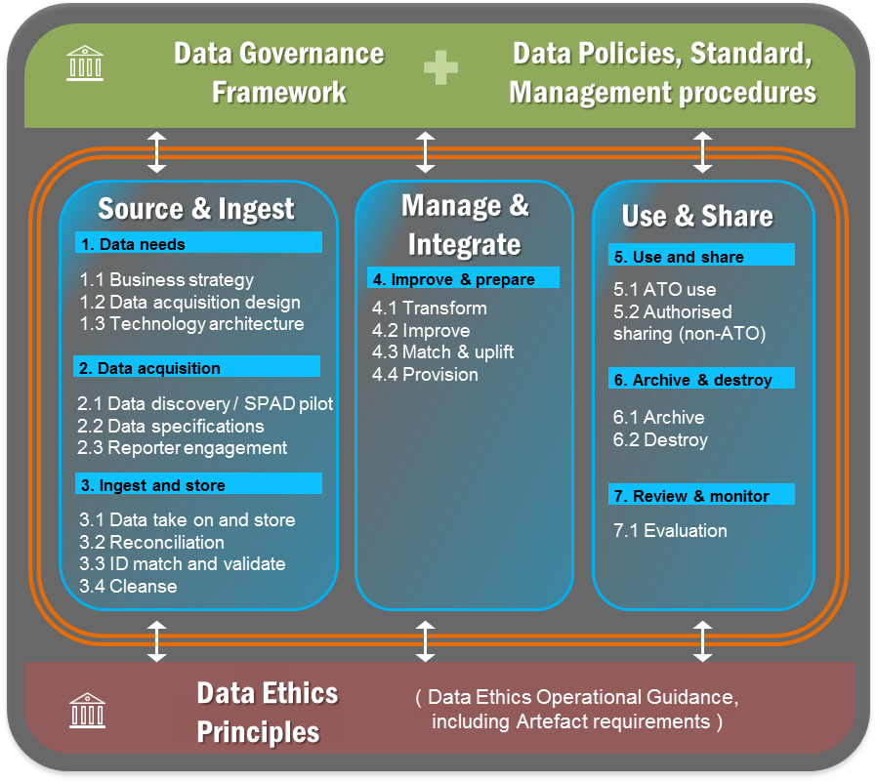
Data Management strategy: Governance components
DMS governance components will be detailed within the DMS and funded for planned delivery and maturity.
Data Governance
Framework
Stewards
Culture
Metrics/monitor
Catalogue
Level 3: Proactive | Level 4: Managed
Policy adherence procedures for key information assets are developed and monitored by information owners and stewards who have limited authority. Formal data quality/integration, metadata and MDM programs emerge, but they tend to focus on small subsets of business data or business outcomes to be improved. Efforts to align governance and stewardship of different kinds of data, spanning content and structured data, start to emerge. | An enterprise information governance organization is functioning (e.g., within the context of the office of the CDO) and carries sway on all IT and business projects. Policies evolve into a full set of precepts (e.g., principles, guidelines, policies, standards, procedures) which are well communicated and enforced. Data quality is largely automated. Information governance priorities are based on business need, not IT demands. Information security and risk are now linked to the same information governance process.
Data Lifecycle
Corporate DM policy suite
Integration of IM and DM
Metrics/monitor
Data Ethics
Principles delivered
Guidelines in progress
Culture planned – not funded
Metrics/monitor planned - not funded

Slide 12
Why Is Data Governance Important
Data governance helps:
that data is discoverable
that data is accessible
that data is usable,
that data is valued and
that data is protected

Slide 13
Why Is Data Governance Important
Data Governance Saves Money
Data governance should lead to data quality, decrease organisational costs in managing data, and increased optimisation to an organisation
Bad Data Governance is Risky
is a security concern;
regulatory compliance concern.
Good Data Governance Provides Clarity
Assurance that your metrics are accurate - how are your KPIs?
Insight into what your most important metrics might truly be
Greater confidence in your analytics

Slide 14
Data Governance In Practice

Slide 15
DATA GOVERNANCE FRAMEWORK
The process of checking and providing assurance that the Data Management Principles have been applied in practice
DATA MANAGEMENT PRINCIPLES
Policy/guidelines
The rules
Process
Bigger picture end to end - systems/ technical solutions
User support
Materials/training/communication needed to ensure compliance to policy
Procedures
Step by step instructions on how staff implement process
Assurance
Evidence can be, and should be, required at all levels.
A combination of these layers is required to support effective data management.
Providing evidence that the various layers are in place and being adhered to.
Different ‘data stewards’ could be responsible for different layers – some with multiple layers – some with only one.
Supported by
Supported by
Supported by
Monitor and evaluate the effectiveness of the policy, process and procedures to determine whether it has achieved intended outcomes.
Data management
Staff manage data in practice

Slide 16
POLICY
A policy is a rule, regulation, or set of guidelines
It reflect the "rules" that govern the implementation of the processes
Example
The policy is that access to the Enterprise Data Hub (EDH) will be granted to staff where they have the right security, the right job, the right skills and the need to access the right data.
PROCESS
A process is a high level set of things that must happen outlining what must happen in order to ensure compliance with a policy.
It outlines defined tasks needed to complete a given business activity, including who is responsible for completing each step, when, and how.
EXAMPLE
The process is that staff will request access to the EDH, central governance will approve the staff request and grant the physical access to the system.
PROCEDURES
A procedure is a specific, detailed series of actions that staff must take in order to implement a process and comply with a policy.
Procedures will:
provide clear instructions on the way policy will be implemented
step through the actions required to implement policy principles
assign responsibilities
enable monitoring of policy implementation
EXAMPLE
The procedure will outline specifics about how this process will be accomplished by the EDH users

Slide 17
EDH Governance work - recipe for success!!
Data governance model
Step 1: What policies do we need?
Step 2: Taking each policy topic we identified in step 1 we need to determine the process (es)
Step 3: Develop the procedures required for the process.
Step 4: Write the policy.
Step 5: Develop user support
Step 6: Governance – develop process to report compliance
Step 7: Assurance – set thresholds and required actions
Committee
Data governance framework
D&A SC charter
Data stewards roles & responsibilities
Accountability
Data ethics principles
Data Domain Stewards
Ethical use of data framework
Data management principles
Data management policy, guidelines & procedures
Data management strategy
Data acquisition policy
Source & Ingest
Data value policy
Supporting Stewardship Roles
Data store policy
Metadata policy
Working Group/s
Manage & Integrate
Accountability
DM tool: data catalogue
Data security policy
Use & Share
Data quality policy
Information and Data Users
Data retention policy
Data share policy

Slide 18
Activity
What Does Governance mean to you;
Name two Data Governance Principles;
Referring to the Gartner's EIM Maturity Model: Strategy – how would you rate your organisation

Slide 19
Session 2
Practical Application across the Data Management Lifecycle
Data defining roles and responsibilities for business processes, systems, and data;
Mapping business processes, data flows, and databases; and
Establishing a data concept model that ensures consistent use of concepts across all databases and fields as well as clearly defined data dictionaries.

Slide 20
Session 2
Data Architecture and Governance Ecosystem
What is it ?
Why is sit important ?
Reference
Architecture
Data Reference
Architecture
Data Ecosystem
Data
Governance
Architecture
Data and
Analytics
Architecture

Slide 21
Session 2: Reference Architecture (TOGAF)
What is it ?
Why is sit important ?
Reference
Architecture
Session 2:A
Data Reference
Architecture
Data Ecosystem
Data
Governance
Architecture
Data and
Analytics
Architecture

Slide 22
Strategic Platforms
COMMUNITY
High level groupings that work together to provided seamless end-to-end experience
Strategic Platforms provide aspirational directions to support the transformation of both the client experience and staff
11 Strategic Platforms are groupings of Capabilities, Applications and Technology.
Case & Work Management
Establishes and manages activities for the client. It uses data insights and intelligence to apply automation treatments, deliver tailored client views, predict actions and present results to ensure staff get the right information for the job.
Identity & Access
Identify the individual we are dealing with, what they can do and who they can act on behalf.
The type of experience and interaction will determine the Strategic Platform required to deliver the tailored experience.
Client Profile
Provides access to all information about our clients, such as their interactions with us, business entities and demographics.
Client Interaction
Provides the entry point for the community to engage with services delivered directly by the in digital and non-digital ways.
Data Exchange
Provides the entry point where we take on third party data and provide curated data as a value add service.
Client-focussed foundation platforms
Client Account
Manages and maintains the client account records which includes their registrations, running account balance and payment activities.
Insights & Intelligence
Uses the data the collected in Event Processing for the analytics, management and application of data to establish the correct actions and generate risk models for case selection, calculating risk profiles and resulting events and actions.
Event Processing
Defines the data we collect and respond to from the community and what business rules we apply over that data to confirm the data is ready for use.
Internally focussed supporting platforms
Corporate Administration
Supports the administrative functions of the Tax Office.
Technology Administration
Supports the administrative functions of all Technology and Applications.
Corporate Workspace
Enables the workforce to access and do their work.

Slide 23
Strategic Platforms, Capabilities, Applications & Technology
Complexity of Strategic Enterprise Systems- start with the building blocks – platform, capabilities, application, hardware
Strategic Platforms
Strategic Platforms
Identity & Access
Client Interaction
Data Exchange
Event Processing
High level functional groupings that work together to give a seamless end-to-end experience for staff and clients.
Authentication
Authorisation
Digital Exchange
Outbound Correspondence
Bulk Data Exchange
Machine-to-Machine Exchange
Event Calculations
Event Publishing
Non-Digital Exchange
Enterprise Content Management
Middleware & Integration
3rd Party Data Exchange
Event Detection
Capabilities
Applications
Applications
Applications
Applications
Capabilities define collective business functions, resources, tools and expertise that support the delivery of Enterprise Services.
Case & Work Management
Client Profile
Client Account
Insights & Intelligence
Workflow Management
Compliance & Dispute Resolution
Consolidated Client View
Client Register
Transaction Management
Data Management
Data Analytics
Case Management
Debt Management
Product Register
Obligation Management
Data Collection & Curation
Artificial Intelligence
Client Account Management
Identity Matching
Applications
Applications
Applications
Applications
Technology Applications
Corporate Administration
Corporate Workspace
Technology Administration
Technology Hardware
Human Resource Management
Financial Management
Staff Workspace
Mobility
App Development & Support
Security
Systems that deliver features and functions that enable and integrate core business processes.
Foundational infrastructure and common services that hosts, supports and secures the applications.
Portfolio Management
Collaboration
Print
Operations & Monitoring
IT Management
Applications
Applications
Applications
Technology Hardware
Data Centre | Hosting | Storage | Network | Database
23

Slide 24
Community, Services, Products & Channels
What happens for the client
Community
Individual
Employees | Families | Sole Traders
Superannuation Funds
Self-Managed Funds | APRA Funds | APRA Exempt Funds
Significants
Global Enterprises | Private & Wealthy Groups
Business
Small & Medium Enterprises | Large Enterprises | Non-Government Organisations
Community
Services
Intermediaries
Payroll Providers | Registry Professionals | Tax Professionals | Insolvency Practitioners
Partners
Software Providers | Government Agencies | Information Brokers | Revenue Agencies
Government
Policy Makers | Treasury | Regulators
An individual, group or representative that interacts with the organisation respect to obligations or entitlements.
The services provided to members of the community in the administration of Tax, Superannuation, Customs and Registry system obligations and entitlements.
Services
Registration
Lodgement
Payment
Reporting
Prefill
Data Sharing
Education Data Literacy
Assistance
Compliance
Products
Channels
Products
Income Tax
Pay As You Go Instalments | Pay As You Go Withholding | Fringe Benefits Tax
Digital
Natural Systems | Web | Portals |  | Mobile App
Virtual Assistant | Web-chat | Email | Secure Mail | Social Media
Channels
Legislative drivers which provide the framework for the administration of the Tax, Superannuation, Customs and Registry system.
Points of engagement with our clients or partners through which Tax, Superannuation, Customs and Registry system services are provided.
Superannuation
Super Guarantee | Surcharge | Other
Non-Digital
SMS | Phone (in & out) | Face-to-Face | Paper (in & out)
Indirect Taxes
Fuel & Tobacco Excise | Value Added Tax | Other

Slide 25
Activity
What does Reference Architecture mean to you;
Name two Strategic Platforms
Name two Ref Arch digital service channels

Slide 26
Session 2: Data Reference Architecture
What is it ?
Why is sit important ?
Reference
Architecture
Data Reference
Architecture
Data Ecosystem
Data
Governance
Architecture
Data and
Analytics
Architecture

Slide 27
WHY IS IT CRITICAL?
The Data Reference Architecture provides the foundational framework to enable strategic planning, management and use of corporate data to make more informed decisions.
PLANNING
It provides a common understanding around the key capabilities needed to support the treatment of data​.
It provides a standardised framework to guide solution and architecture design.
It provides an agile and modern architecture to enable us to better leverage emerging technologies to advance our data and analytics capabilities.
MANAGEMENT
It provides a consistent model of how we treat data as it is received, stored, processed and used in the organisation ​.
It encourages adherence to standards, specifications and patterns.
It provides a modalized approach to improve flexibility and the ability to respond to changes and limit the impact of these changes.
USE
It supports the validation of solutions against proven Reference Architectures​.
It is technology independent and enables us to change solution components and hosting platforms seamlessly to allow for evolving business requirements and technical improvements over time.
27

Slide 28
DATA REFERENCE ARCHITECTURE – MODEL: KEY COMPONENTS
The Data Reference Architecture Model contains the following key components:
Cross layer capabilities: The capabilities used across all Data Reference Architecture layers to manage data quality, discoverability, contextual fitness-for-use and support for non functional requirements such as security and availability.
Data consumption: Methods and means as to how data is consumed and used to support business purposes.
Data services: Services and related technologies used to securely make data available for consumption.
Data storage and processing: The grouping of capabilities where incoming data is processed, stored, curated, analysed, enriched and insights derived to deliver business outcomes.
Data ingestion pipeline: Technologies and related processes for the input of data from providers.
Data provider: Sources that provides or inputs the data.
CROSS LAYER CAPABILITIES
DATA CONSUMPTION
DATA SERVICES
DATA STORAGE & PROCESSING
ENTERPRISE DATA CORE
FAST, COMPLEX EVENT PROCESSING
DATA SCIENCE
SYSTEMS OF RECORD
INGESTION PIPELINE
SOURCES - DATA PROVIDER
28

Slide 29
DATA REFERENCE ARCHITECTURE – MODEL
CROSS LAYER CAPABILITIES
DATA CONSUMPTION
Self Service
BI & V
Alerts & Notifications
Downstream Systems
External Systems
Operations
DATA SERVICES
API Manager
Streaming
Batch
Direct Access
Virtualisation
Index & Search
Governance
FAST, COMPLEX EVENT PROCESSING
ENTERPRISE DATA CORE
DATA SCIENCE
Curated Data
Query Engine
Metadata Mgmt.
DATA STORAGE
&
PROCESSING
Tailored View
Event Analytics
Production Model Execution
SYSTEMS OF RECORD
Business View
MDM/RDM
Base View
Event Detection
Model Development
Data Integration & Transformation
Data Catalogue
Stream Processing
Data Storage
Disaster Rec.
INGESTION PIPELINE
API
Streaming
Messaging
Batch
Data Security
SOURCES
– DATA PROVIDER
Client Data
Business Data
3rd Party Data
Logs and System Data
Event Data
29

Slide 30
DATA REFERENCE ARCHITECTURE - PRINCIPLES
Guiding Principles – used to guide and assist the development of the Data Reference Architecture Principles
Data is treated as a corporate asset
Increase trust and confidence in the data
Empower staff with timely access to the right data
Data is used to inform decisions and deliver value for the clients
Modern and flexible architecture that is technology agnostic
Principles
An enterprise approach to strategically plan and manage data
Data is meaningful, easy to find and secure
Data is used to deliver value and inform decisions
Architecture to support flexibility and agility, and to optimise the value and benefits of data while reducing associated costs
Augmented data catalog to register corporate data
Data is defined consistently across enterprise
Streamline governance for industrialisation of analytical insights
Componentised approach to improve flexibility and the ability to respond to changes
Align technology platforms to support appropriate capabilities
Adhere to Enterprise Data Model
Unified metadata management to support consistent classification, tagging and cataloguing of data
Business values and consumption requirements drive solution design
Data is managed through its lifecycle with clear stewardship
Strict governance on access to Systems of Record
Store enterprise data on the Enterprise Data Core
Strategies / sub-principles
Consistent standards and rules to guide data processing operations
Data is protected from unauthorised or unintended use and disclosure
Enhance businesses ability to realise the value derived from analytical insights
Automation of processes and flows wherever practical
Data transformation happens on the Enterprise Data Core
Cohesive and differentiated data governance across enterprise
Retain and preserve data lineage throughout data lifecycle
Keep a persistent copy of data received from data providers
Curated data requires central control and quality assurance
Utilise data & insights to support business decisions
Data quality measurements are specified
Data is easy to find and fit for purpose
Analytical insights need assessment and governance before feed into data core
Ingestion pipeline supports different data types, patterns and multiple SLAs
System of record is protected by a layer of controls or physical separation
Reuse before acquire new data
A single authoritative
source of truth
Ingestion
Storage & Processing
Consumption
Cross Layer
30
Notes:
Data should be readily accessible, discoverable and valued to enable users to perform their functions.
Data is protected from unauthorised use and disclosure.
Data is defined consistently throughout the enterprise, and these definitions are understandable and accessible to all users.
Quality requirements are specified, rules to measure quality and transform data will be defined
Allows for the rapid ingestion of data and facilitates the use and storage of raw data
Data ingestion capability needs to recognize different data types, patterns and multiple SLAs

Slide 31
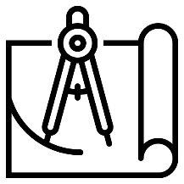
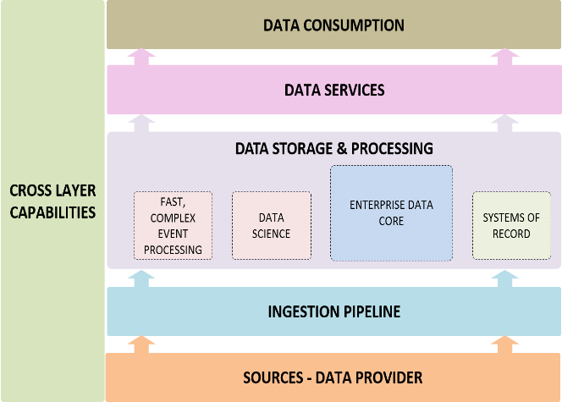
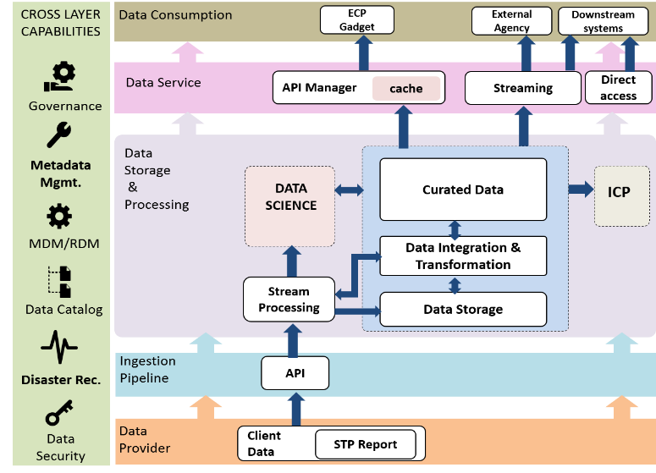
A STANDARDISED FRAMEWORK FOR SOLUTION & PATTERN DESIGN
As a Solution Architect, I need to develop new or refine existing patterns.
With the Data Reference Architecture I can:
start the design based on a standardised framework.
find the building blocks to support business requirements based on data characteristics.
develop new patterns with the chosen technical building blocks.
refine existing patterns by only changing the relevant technical building blocks.
validate my design against the proven reference architecture.
As a Solution Designer, I need to design solutions to meet business requirements.
1. Standardised framework
2. Understand requirements
3. Choose the right building blocks
4. Form the pattern
Baseline with the standardised framework
Understand data characteristics, business requirements, SLA of use cases
Data Characteristics
1st party vs 3rd party data
Data formats?
Data quality?
ID Matching required?
Security classification?
Business requirements
SLA?
Internal use?
Share with external?
Volatility of Data
Select the appropriate technical building blocks at each layer to meet requirements
Develop the end-to-end execution (Pattern and/or solution) based on the chosen combination of technical building blocks
31

Slide 32
INTENDED USE
A HOLISTIC VIEW TO ENABLE BETTER COLLABORATION & CAPABILITIES ENHANCEMENT
As an Executive, I want to enhance our capabilities to better support the transition to a data driven organisation.
I can refer to the Data Reference Architecture to obtain:
a good understanding around the key capabilities to support my analysis and decision making on capability planning
As a Branch Head, I want to work with other areas within the organisation to achieve our strategic goals together.
I can refer to the Data Reference Architecture to obtain :
a shared understanding around the key capabilities required to support the treatment of data to assist the conversation and collaboration with different areas within an Enterprise .
A CONSISTENT MODEL FOR BETTER & CONSISTENT DATA OPERATIONS
As a Data Engineer, I need to find the right data and the technical building blocks to perform operations to the data to deliver the required business outcomes.
With the Data Reference Architecture I can:
find the technical building blocks that I need to use for the operation.
find the right data via the data catalogue.
understand the cross layer capabilities that apply to the data operation.
see the impacted areas by my operations and follow the right governance process.
As a Data Management Officer, I need to make sure our data is properly governed and managed.
With the Data Reference Architecture I can:
understand the guiding principles to develop data management policies and standards.
understand the capabilities required to support effective data management.
32

Slide 33
Activity
What does Data Reference Architecture mean to you;
Name two Ref Arch digital service channels
Name the four steps in creating a standard framework for solution and pattern design

Slide 34
Session 2: Data and Analytics Architecture
What is it ?
Why is sit important ?
Reference
Architecture
Data Reference
Architecture
Data Ecosystem
Data
Governance
Architecture
Data and
Analytics
Architecture

Slide 35
Strategic Themes
The key architectural and design principles and roadmap
Optimisation
Modernisation
Rationalise our applications landscape
Adopt workflow automation first policy .
Harness opportunities to modernise with
the rapidly evolving data landscape
Cloud-First
Take a cloud-first approach, and use cloud-native solutions to establish patterns that can be replicated, scaled and re-used.
Innovation
Agility
Adopt a strategic practice to innovation and evolve toward a culture where change is accepted as a norm through continuous improvement.
Scale the solution dynamically through cloud-native approaches, standard patterns and reusable components.
35

Slide 36
Principles
Principle | Description
1. Cloud Native First | Select applications and technologies that are designed to embrace the benefits and constraints of public cloud computing. At the same time, exploit cloud native components and functionality to maximise benefits from a cost, resilience and security standpoint, while avoiding costly and complex ‘lift-and-shift’ approaches.
2. Service Before Product | Prefer consuming a capability ‘as a Service’ over installing, configuring and maintaining the same capabilities ourselves. Consideration needs to be given to the TCO, SLA and security/privacy implications of ‘as a Service’ capabilities.
3. Use Case Driven | Changes to the platform will be based on business requirements derived from use cases. Organise the solution and its delivery around business-relevant functional capabilities and not technologies silos.
4. Control Technical Diversity | Integrated platforms will be preferred over disparate products, minimising non-trivial costs of maintaining skills, expertise and connectivity between systems.
5. Open Standards | Products and services that support open standards will be preferred, in order to support interoperability and extensibility.
6. Automation | Automate testing and deployment to enable rapid and shorter delivery cycles for solution features. “If a solution is too hard to automate, it’s probably the wrong solution.”
7. Design For Agility | Capabilities including business processes, information, applications and technical assets will be designed to evolve and adapt within the context of a dynamic and changing environment.
8. Data Is An Asset | Data will be treated as an Enterprise Asset and managed accordingly well-defined Data Governance and Management model.
9. Ensure Security And Privacy | Information and resources will be secured in compliance with Australian and International laws, regulations and standards (including access control, authorisation, logging and audit).

Slide 37
SYSTEMS OF RECORD
A system of record refers to the data storage and retrieval system that is the authoritative source for a particular data element in the enterprise where multiple sources of the same element reside in different systems. To ensure data integrity, there is one and only one system of record for a given piece of information/data.
The system of record provides the most complete, most accurate and most timely data, it has the best structural conformance to the data model, it is nearest to the point of operational entry and it can be used to feed other systems.
ENTERPRISE DATA CORE
SYSTEMS OF RECORD
Curated
Data
Client Register
Case
L & D
Client Accounting
Activity
HR
Data Integration & Transformation
Work Management
Payroll
Procurement
Business rules
Finance
Others
Data Storage
Risks
Ingestion Pipeline
37

Slide 38
ENTERPRISE DATA CORE
Enterprise Data Core, is a logical grouping of capabilities where data is being stored, processed, and organised to support operations and reporting. This is where data is used to derive insights to inform decisions to support better operations and services to clients.
DATA SCIENCE
Enterprise Data Core
Data lands in Raw Zone when it firstly arrives at the Data Core
Data is cleansed and validated in the Staging Zone,
Processed Zone contains data that has completed the Standardisation Process, but hasn’t been loaded into the Curated Layer.
Data is then integrated and transformed to prepare and provide data designed for Business use and access; e.g. sensitive data is screened, corrupted formats and duplicates are removed, data is metadata tagged to facilitate searching and sorting, etc.
Data after transformation is pushed into the Curated Data layer as a Base View. Further business logic & refinement are then applied to provide specific data views for Business Units (Business View) and specific data products such as recommendation engines (Tailored View).
Data Science takes data from enterprise data core as input to their analytical models, and send the outcomes back into the Business View and Data Storage via Data Integration & Transformation to provide insights and add value.
Fast Complex Event Processing (Fast CEP) sends output from event analytics back to the Business View (as needed) and Data Storage via Data Integration & Transformation.
Query Engine enables different types of queries to run against data layers.
Production Model Execution
6
5
Curated Data
Query Engine
8
Tailored View
Interactive Queries
Model Development
Business View
SQL Like Access
Multi-Schema Access
Base View
FAST, COMPLEX EVENT PROCESSING
Event Analytics
Data Integration & Transformation
4
7
Batch processing
API
Stream / Queue
Event Detection
Data Quality
Data Enrichment
Data Refinement & Extension
Stream Processing
Data Storage
1
2
3
Ingestion Pipeline
Raw Zone
Staging Zone
Processed Zone
38
38

Slide 39
Governance, Access Security & Controls
Components Model - Overview
The foundation of a modern data platform consists a number of components to store, process and consume data/insight. The below component model illustrates the stages of data throughout it’s lifecycle. Datasets in each stage will have different characteristics.
Information Delivery Stage
Built for purpose datasets that are specifically designed and materialised to optimise their utility for a specific small number of use cases
Will often include elements from multiple raw/curated data sets but are not expected to be reusable.
Dynamic component; will add/change over time based on use cases, business needs and emerging technologies
Governance, Security & Controls
Data Services
BI & Reporting
Exploration & Ad-Hoc Analysis
Data Science & Advanced Analytics
Machine Learning & Intelligence
Collation Stage
Datasets that have been processed from standardised Data. These are centrally controlled and managed to service as data source for Consumption Stage.
Includes curated data sets; data that is fundamental to business and expected to be used in a high percentage of analytics use cases.
Variable component; can add/change over time based on processing patterns and emerging technologies
In Memory
(Cache)
Fast Access Storage
Batch Process
In Memory
In Memory
In Memory
In Memory
In Memory
In Memory
Acquisition Stage
Consists of Raw Data and Standardised Data:
Raw Data is exact copies of source data to the extent the law and internal policies allow
Standardised Data is validated and normalised into the expected structure and format
Enduring component; components rarely change over time
Data Core

Slide 40
Components Model – Data Flows
The rate at which data is required will depend on the specific use case, and affect the solution required. The below summarises “Hot” and “Cold” Data flows; the extremes at each end of the spectrum.
“Hot” Data
Fast moving data
streams
“Cold” Data
Slow moving data
batches
“Hot” Data
Data path for fast moving data from data streams required .
Include data required for real time or near real time requirements.
Queries at the consumption stage should take <100ms¹ and only a small amount of data is expected to be access per query.
Real Time and Transactions
Analytics
Strategic Themes
In Memory
(Cache)
Fast Access Storage
Batch Process
“Cold” Data
Data path for slow moving data required for data analytics.
Includes data for batch processes or for exploratory and discovery requirements
Queries at the consumption stage are asynchronous. A large amount of data may be accessed each query.
In Memory
In Memory
In Memory
In Memory
In Memory
In Memory
Data Core

Slide 41
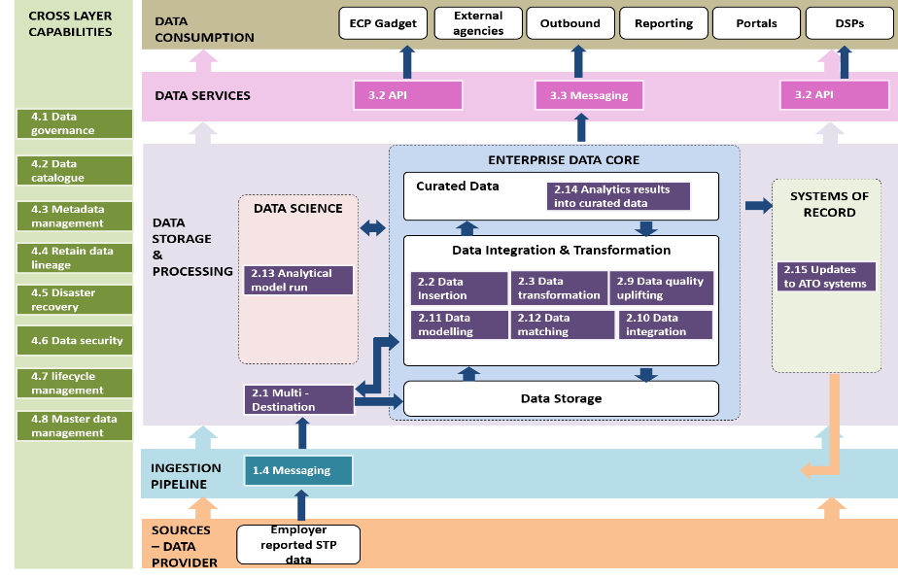
USE CASE
Standardised framework and technical building blocks to design end to end data flows to support business requirements.
1. Standardised framework
2. Understand requirements
3. Choose the right building blocks
4. Form the pattern
Data Characteristics
External party reported data (Employers and employees details) and initiated corrections
Data is of known formats (Pre-defined)
ID matching required for employee data
Data is informational but feeds into processes.
Can potentially contain non-tax data.
Business requirements of the data
Data is processed and made available to support multiple processes
Analytical models to analyse and provide actional insights for tailored client engagement and treatment
Employee data to be shared with external parties
Support reporting requirements
4.1 Data governance
4.2 Data catalogue
4.3 Metadata management
4.4 Retain data lineage
4.5 Disaster recovery
4.6 Data security
4.7 lifecycle management
4.8 Master data management
3.2 API
3.3 Messaging
2.1 Multi- Destination
2.3 Data transformation
2.2 Data insertion
2.9 Data quality uplifting
2.10 Data integration
2.11 Data modelling
2.12 Data matching
2.13 Analytical model run
2.14 Analytics results into curated data
2.15 Updates to systems
1.4 Messaging

Slide 42
Activity
What does Data and Analytics Architecture mean to you;
Name two Strategic Themes of Data and Analytics Architecture
Name the two data flows within the data core concept
42

Slide 43
Session 2: Data Governance Architecture (DAMA)
What is it ?
Why is sit important ?
Reference
Architecture
Data Reference
Architecture
Data Ecosystem
Data
Governance
Architecture
Data and
Analytics
Architecture

Slide 44
Logical Data Governance grouping
Capabilities Model – Level 2
Each of the logical grouping consists of a set of similar capabilities, together represents the end to end functional capability
Governance
Architecture Review Board
Data Review Board
Policies & Standards
Strategy & Roadmap
Data Stewards & Ownership
Data Mgmt/Catalogue
Core
Metadata Mgmt
Data Classification
Semantic Models
Audit Logging
Data Dictionary
Data Access Model
Innovation
Creative Analytics Enablement
Software Evaluation
Prototyping/Experimentation
Midrange
Business Users
Data Collection
Data Provisioning
Insights & Actions
Discovery
Intelligence
Exposed Analytics
Artificial Intelligence
Data Analysts
Data Curation
Data Exploration
Entity Resolution
Deep Learning
Batch
/ Bulk
Data Quality
Decision
Optimisation
Online Analytics
Machine Learning
Messages
Data Visualisation
Case Intelligence
Real-time Streaming
Entity Matching
Batch Analytics
Statistical Modelling
External Data Sharing
Natural Lang. Proc
Transformation
Reporting
Index & Search
Network Analysis
Text mining
Micro-batch Streaming
Sentiment Analysis
Data Consumers (Internal & External)
Data Sources (Internal & External)
Risk Profiling/Modelling
Image Recognition
Data Disposal
Business Rules Modelling
Business Applications
Unstructured data
Advanced Analytics
Data Scientists
Entity Extraction
Enterprise Planning & Forecasting
Behavioural Analytics
Speech Recognition
Cognitive OCR
Compute
& Storage*
Data
Store*
Data
Processing*
Data
Consumption*
Raw
Historical
Trusted
Archive
Batch
Indexing
Event
Interactive
Bulk
Partner Agencies
Object Store
Relational
Columnar
Media
Geospatial
Graph
Transactions/API
Other 3rd Parties
Security*
Partner Agencies
Authentication
Authorisation
User Provisioning / Mgmt
Security Monitoring / Auditing
Role Base Access Control
3rd Parties
Infrastructure
and Operations*
Compute
Storage
Network
IaaS
PaaS
SaaS
Scaling
High Avail
Multi-tenancy
Backup / Restore
App Monitoring
BCP
Maintenance
Automation & Monitoring
Service Management
Capacity Planning

Slide 45
Technical > Functional Capabilities
The example above shows the Data Provisioning capability and how it currently sits across various technical capabilities.
Functional Capability Model
Governance (Manage how the platform is being developed and utilised)
Data Management / Catalogue (managing data within the enterprise data platform)
Technical Capability Model
Innovation (learn and experiment with new ways of working)
ENTERPRISE DISCOVERY
AND INTELLIGENCE
Data Collection
Ways the data are collected and ingested into the platform
Data Provisioning
Fit for purpose curation / transformation of data
Insights and Actions
Extract information and value from data
Discovery
Explore, model and search data for patterns / profiles
Intelligence
Advanced analysis and analytics to extract value
Exposed Analytics
Sharing of analytical insights
Artificial Intelligence
Advanced machine based learning
ENTERPRISE INFORMATION
MANAGEMENT
Data Management
Identify Matching
Metadata Management
Risk Profiling`
Ad-Hoc reporting
Data Quality
Enterprise Data Models
Master Data Management
Visualisation
Data Virtualisation
Data Sources (Internal & External)
Data Consumers (Internal & External)
ENTERPRISE
DATA HUB (EDH)
Network Analysis
Search and Index
Data Access
Storage
High Volume/Unstructured
Workflow Scheduling
Compute & Storage (Data Store, Processing and Consumption Methods)
Discovery matching
Case Intelligence
Security
Process/ Resource Mgt
Import & Wrangling
Security (Infrastructure, Application, Data & Users)
Infrastructure and Operations (Infrastructure / Application)
ENTERPRISE ANALYTICS
ENTERRPISE DATA WAREHOUSE
Batch Analytics
Operational Data Store
Online Analytics
Enterprise Planning
Enterprise Reporting
At a high level, the Data Analytics capabilities consists of 7 core functional groups underpinned by
5 supporting Data Governance functional groups
Content Analytics
High Perf. Analytics
Decision Optimisation
Relational Data Storage

Slide 46
Cross Layer Capabilities
Cross layer capabilities refer to the use of defined capabilities across the layers to manage data quality, discoverability, contextual fitness-for-use and support for non functional requirements such as security and availability.
Data Governance
Metadata Management
Data Catalogue
Master data management
Data Security
DATA CONSUMPTION
User access control
Metadata discovery
Data Recommendation
Define Master Data objects
Identity & access management
Severing data based on SLA and standards
Semantic framework
Data classification & security controls
DATA SERVICES
User Collaboration
Define Master Data attributes
Govern data movements
Impact analysis
Network security
Intelligent Population
DATA STORAGE
&
PROCESSING
Govern data curation
Data quality matrix
Define dependent data stores / systems
Privacy management
Perform data quality
Data relationship discovery, analysis and visualisation
Build and Retain data lineage
Software development security
Apply security
Record sensitive data presence
Master Data matching & linking
Security governance & risk management
Data Mapping & Data Dictionary
Security control testing
Insert data & complete data validation
Capture operational metadata
Describe & apply Master data business rules
Apply metadata
Metadata integration & analysis
Capture business context & meaning
Security evaluation & vulnerability management
Catalogue data
Record metadata enhancements
Taxonomy and data classification
Manage location data (e.g. GPDR)
Logging & monitoring
INGESTION PIPELINE
Data ingestion gateway
Metadata ingestion and storage
Business continuity & disaster recovery
Register Data
Data integration and updates
DATA PROVIDER
Assign Data Stewards
Business Metadata collection
Data encryption & cryptography
46

Slide 47
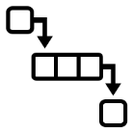
Data Standardisation
An example data standardisation framework enabled with rules editor and processing engine.
RAW ZONE
DATA STANDARDISATION PROCESS
STANDARDISED ZONE
PROTECTION
STANDARDISATION & VALIDATION
PROMOTION
BATCH DATA
DATA
FORMATTING
& VALIDATION
BATCH DATA
***
SENSITIVE DATA DETERMINATION
ACCESS
STAGE
DATA
CLEANSING
STREAMING DATA
STREAMING DATA
TOKENISATION, ENCRYPTION, MASKING
DATA
CONVERSION
PROVISIONING PROCESS
MESSAGES
STANDARDISATION RULES UI EDITOR
STANDARDISATION RULES ENGINE
UNCLASSIFIED

Slide 48
Metadata Management - Classification (Data Elements)
Metadata is the definition of data. Metadata provides technical, business and operational information elements about data to support a data-driven culture within the organisation.
BUSINESS METADATA
TECHNICAL METADATA
OPERATIONAL METADATA
Business metadata describes how the data will be used within the business
It may also capture the business rules, business metrics, and information authored by business users
Technical metadata can be divided into catalogue and structural information about data
Catalogue information further captures into entity and attribute level information of the data
Technical metadata focuses on building a physical and logical view of the data
Operational metadata includes all information about the currency of the data and may include specifications covering processing jobs, applications, linage and other operational information of processes
Supports maximised operational uptime through feeding operational metadata to be used as part of system monitoring
PROFILING INFORMATION
Dataset-level profiling
Count
Max
Mean
Allowed values
Uniqueness
Length
Null count
Header inference
STRUCTURAL INFORMATION
Source of data
Target of data
Tools used
CATALOGUE INFORMATION
Header inference
Schema inference
Hierarchies and folders
Entities inference
Domain areas
BUSINESS INFORMATION
Business terms
Business rules
Semantic relationships
Data governance rules/policies
Sensitive data classification
Data owners
OPERATIONS INFORMATION
Lineage
Data lifecycle
Audit
EXECUTABLE METRICS
Jobs run
Last time executed
Frequency of run
Status of run
Scheduled or ad-hoc run

Slide 49
Nine Pillars of Data Governance
Data Governance helps to define regulation, process and structure to the data platform. It ensures that data is nicely organized and available for important processes and applications and that sensitive, non-compliant data is never promoted or accessible. Data governance is a collaboration between People, Process & Technology.
9 PILLARS OF DATA GOVERNANCE
Metadata Mgt | Collect business, operational and technical metadata across the data-pipeline to design compliance, security and data management policies.
Data Profile & Catalogue | Data catalogue and profile of the data to understand the distribution and patterns of the data to create a comprehensive picture of the data.
Policy Mgt | Use policy management to define, communicate, maintain and manage best practices and recommendations into reusable policy.
Security & Audit | Using the right security process and foundation to build platform, network, data and process security with continuous auditing and monitoring.
Data Lifecycle Mgt | Manage and maintain data life-cycle policies to define data standards and practices that can help manage storage costs.
Access & Authorization | Build dynamic security process that ensures right access and right entities are available to right users.
Lineage & Tracking | Understand the data usage, history of operations and sequence of operations within the data-lake.
Search & API | Process that ensures policies, metadata, glossary, recommendations etc. are accessible and shared across systems using API.
Business Glossary & Dictionary | Build a dictionary or business glossary defining the data structure, schema, meaning and common vocabulary of data elements for everyone within org.
KEY GOVERNANCE PROCESSES
Pre-Ingestion | A phase of data pipeline, before ingestion that requires data owner to get approval for any new dataset to be loaded into data-lake.
Actionable Policies | Rules build from metadata, organizational mandates, security needs etc. that are executed on datasets automatically.
Staged Ingestion | Process that ensures that data is loaded and rules are executed in different zones/sections to manage data in a more modular and decoupled way
KEY GOVERNANCE STAKEHOLDERS
Data Owner | Someone who has a business reason and justification to load new data into data-lake. Normally a CTO, CIO or even project manager.
Business Steward | Governance Champion who understands organization policy and can approve/reject request.
Data Steward | Part of Governance Council who works closely with Platform admin to onboard new dataset and provide final approval

Slide 50
Metadata Management - Workflow
Capturing metadata is a continuous activity throughout the data lifecycle. The Metadata Management Workflow is a progressive process to capture various types of metadata to be made available within a centralised metadata repository.
CRITICAL DATA ELEMENTS
BUSINESS METADATA
TECHNICAL METADATA
OPERATIONAL METADATA
CENTRALISED METADATA REPOSITORY
Identify and define critical metadata elements which are of value
Associate known information derived from actual data to critical metadata elements
Gather business information and justification of data from business users
Build business profile and catalogue through header and schema parsers
Build technical profile and catalogue through header and schema parsers
Build entity extraction process to enhance technical profile
Build operational metadata and statistical execution information
Integrate with platform metadata capabilities to enhance lineage, audit and access information
Consolidate all critical metadata elements into a centralised metadata repository
Promote exposure of metadata for searching and external integration
METADATA WORKFLOW WITHIN DATA LIFECYCLE
INGESTION
STAGING
PROVISIONING
CURATION
EXPLORATION
INTEGRATION
METADATA REPOSITORY

Slide 51
Data Stewardship - (sample RACI )
Data Governance Data Stewardship RACI across primary, secondary and tertiary data.
Iteration 3: Target state RACI
 |  | Data Management Lifecycle Model
Business Service Line | Role | Strategy | Source & Create |  | Store & Manage |  | Use & Share | Archive & Dispose |  | Experience
 |  |  | Data Needs | Data Acquisition | Ingest & Store | Improve & Prepare | Use & Share | Archive & Destroy | Review & Monitor
Business | Business Data Steward
EST (Technology) | Data Enabler
Data and Analytics Group | Data Lifecycle Manager
R
A
R
A
R
A
C
I
C
I
R
A
R
C
R
A
R
A
C
R
C
R
C
R
A
R
C
R
R
A
C
I
R
C
R
C
R
C
R
C
R
A
R
R
C
R
C
R
R
Responsible: At least one role to do the work to complete the deliverable/task
A
Accountable: Ultimate sign off/approval for the deliverable or task
C
Consulted: Role whose opinion is sought
I
Informed: Role who is kept up to date
51

Slide 52
From Data Governance Architecture to Data Management Lifecycle
Today | Lack of collaboration | Be-spoke & manual data pipeline | Fragmented governance | Fragmented quality assurance | Poor visibility of data Clunky and manual | Disparate engagement
Tomorrow | Early & continuous collaboration | Re-useable & automated data pipeline | Centralised catalogue of automated controls | Curated clean data | Automated & compliance controls | Monitor and improve
Shift | Clear requirements & alignment | Re-useable data pipeline | Standardised governance | Standardised quality assurance | Enterprise compliance | Continuous engagement
Benefit | Speed to market | Simplified sourcing Speed to market | Safe & Secure data | Continuous quality assessment Trust in data | Confidence in legislative compliance | Faster cycle time Boosted insights
Value unlocked for Data Stewards
I am able to access data faster
I can trust this data
I’m confident making a decision with this data
I’ve got an avenue to make improvements to this data
5
Notes:
Strategy:

Slide 53
Live Activity -
Data Catalogue & Lineage
A single source of truth capture our data asset enabling our team visibility of the data asset that we have
Data Catalogue and Lignage
Live discussion
What will be delivered & when

Slide 54
Activity
What does Data Governance Architecture mean to you;
Name one of the metadata classifications
Name the data flows within the Data Management Lifecycle

Slide 55
Session 3:
Learnings
Role of the Data Steward / Data Custodian
Governance as a Discipline
The Future of DA - Event based, Real time streaming, micro services and interoperability
The role of the Experience Owner / Client Owner

Slide 56
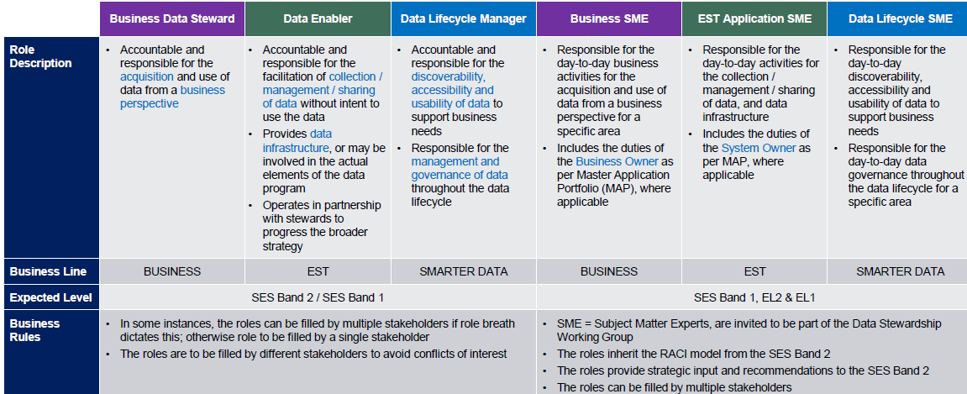
CONTEXT – Roles of the Data Steward and Data Custodian
The Data Stewardship RACI and Roles & Responsibilities will provide clarity on the key decision points and decision owners across the data lifecycle.
1. TARGET STATE RACI
2. ROLES & RESPONSIBILITIES
RACI is an acronym for responsible, accountable, consulted, and informed. Each represents the roles and levels of involvement of a stakeholder against the corresponding activities throughout the data lifecycle.
3. DATA STEWARDSHIP IMPLEMENTATION COMPONENTS
PEOPLE CHANGE MANAGEMENT
EMBED INTO DATA CATALOGUE
ENTERPRISE ALIGNMENT
POLICY IMPLEMENTATION
Focuses on alignment with Reference Architecture & Master Application Portfolio (MAP)
Focus on alignment with s strategic initiatives and business engagement model
Focuses on the development of the Data Stewardship Model in Data Management f Executive Instructions, supporting guidance material, and preparing the material and sessions for the on-going review and enforcement check points
Check for any inconsistencies between policy and business operations, and with guidance materials
56

Slide 57
CONTEXT – Data Governance as a Discipline
Data - A series of facts that have been collected, stored, processed and/or manipulated but have not been organized or placed into context. Data consists of raw, unorganised information such as a numerical figure, word or character, from which information can be extrapolated and interpreted only when given context. When data is organised and contextualised, it becomes information.
Information -The representation of an object, event or a concept. Information can be processed and used to draw generalized conclusions or knowledge. Information exists in many forms and includes our business records, our clients’ information, and the data we use to manage high-volume transactions with appropriate quality, security and privacy.
Data and Information are intricately tied. They are often used interchangeably but they are distinct concepts and are addressed distinctly.
The collect, store, process, use and share data to support organising and putting data into business context to extract information is covered in the Data Reference Architecture.
57

Slide 58
Event based, Real time streaming, micro services and interoperability
CROSS LAYER CAPABILITIES
DATA CONSUMPTION
Self Service
BI & V
Alerts & Notifications
Downstream Systems
External Systems
Operations
DATA SERVICES
API Manager
Streaming
Batch
Direct Access
Virtualisation
Index & Search
Governance
FAST, COMPLEX EVENT PROCESSING
ENTERPRISE DATA CORE
DATA SCIENCE
Curated Data
Query Engine
Metadata Mgmt.
DATA STORAGE
&
PROCESSING
Tailored View
Event Analytics
Production Model Execution
SYSTEMS OF RECORD
Business View
MDM/RDM
Base View
Event Detection
Model Development
Data Integration & Transformation
Data Catalog
Stream Processing
Data Storage
Disaster Rec.
INGESTION PIPELINE
API
Streaming
Messaging
Batch
Data Security
SOURCES
– DATA PROVIDER
Client Data
Business Data
3rd Party Data
Logs and System Data
Event Data
58

Slide 59
Roles within the Data Management Lifecycle
Today | Lack of collaboration | Be-spoke & manual data pipeline | Fragmented governance | Fragmented quality assurance | Poor visibility of data Clunky and manual | Disparate engagement
Tomorrow | Early & continuous collaboration | Re-useable & automated data pipeline | Centralised catalogue of automated controls | Curated clean data | Automated & compliance controls | Monitor and improve
Shift | Clear requirements & alignment | Re-useable data pipeline | Standardised governance | Standardised quality assurance | Enterprise compliance | Continuous engagement
Benefit | Speed to market | Simplified sourcing Speed to market | Safe & Secure data | Continuous quality assessment Trust in data | Confidence in legislative compliance | Faster cycle time Boosted insights
Value unlocked for Data Stewards
I am able to access data faster
I can trust this data
I’m confident making a decision with this data
I’ve got an avenue to make improvements to this data
5
Notes:
Strategy:

Slide 60
Developing a DATA GOVERNANCE PROGRAM OF WORK
Initiatives
Key Deliverables
Priorities
Data Governance
Data Stewardship
Data Ethics
Data Catalogue & Lineage
Enterprise Metadata
Data Quality
Data Sharing
1
2
3
4
5
6
7

Slide 61
Thank You !!!
Questions

