Slide 1
Third Party Data
Masterclass – Executive Program Tax and Digital Transformation

Slide 2
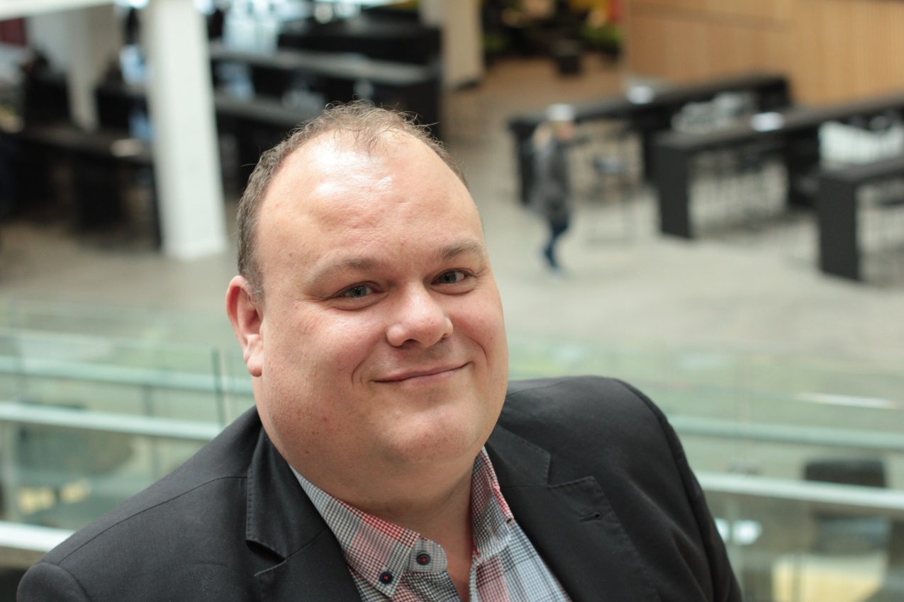
Morten Bøhm
Master in science in business law and business administration
Master in Public Governance
Current position: Program Director for the Tax Programs at VIA University College
Formerly worked at the Danish Tax Administration for 21 years
Held positions Head of the Danish International Tax Evasion Projects
Deputy Director with the Danish Tax Administration
Head of the Nordic cooperation on International Tax evasion
Member of the TFTC and the Jitsic project group at OECD.
Klik for at redigere i master
Notes:
First of all, thank you for the opportunity to speak at this event, Im very glad to be here. If theres any questions or things that need to be clarified please - Do not hesitate to use the chat.
If I can be of any asistence after the presentation, do contact me.
Im gonna give an insigt into the degree of digitaliztion in Denmark, and give an insigt into how in- and outbound banktransactions data are used to detect fraud. And hopefully i will proof why the bank data, is so important for tax purposes.

Slide 3
Agenda - cases
Annual Tax Return
Tax Evasion Projects – Money Transfer
Automatic Exchange of Information
CRS, FATCA, DAC etc.
Leaks
Fake leaks
Scrapes from Internet
Klik for at redigere i master

